Slide 1
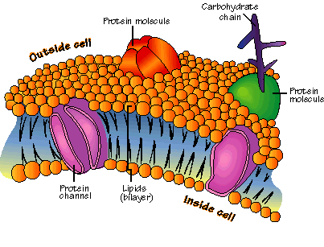
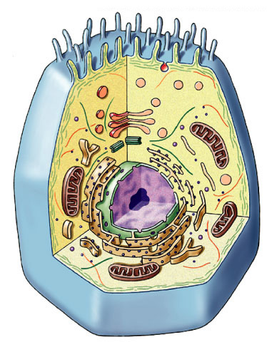
Movement across the Cell Membrane

Slide 2
Do Now 02.01.16
Get into groups of 4.
Obtain a Passive and Active Transport Venn diagram, large paper, and a black marker.
You will have 10 minutes to complete the Venn diagram with your group.
After the 10 minute period, the diagrams will be posted for a 5-minute gallery walk. Your group will receive a marker. As you walk, put question marks next to items that your group feels may not be in the correct place.
Be prepared to defend your placement of terms, phrases, or question marks.

Slide 3
Passive Transport vs. Active Transport
Passive | Both | Active
No Energy Needed Osmosis Facilitated diffusion Simple diffusion No ATP required Down concentration gradient From high to low concentration Moves water Protein channels* | Uses proteins Moves molecules across membrane | Endocytosis Requires energy Exocytosis Against concentration gradient Phagocytosis Pinocytosis From low to high concentration Moves large particles Uses vesicles Requires ATP Proton pumps Protein pumps*
* Not on your sheet

Slide 4
Passive & Active Transport Video 6:12
Jot down 2 new real-world pieces of information that you learned from the video.

Slide 5
Sodium – Potassium Pump Na⁺ - K⁺ Pump
Active Transport
Pumps Sodium Ions out of the cell and Potassium ions into the cell
Mnemonic Device - NaO Kin
Responsible for driving your nerve impulses
1/3 of what you eat is solely for these to work
Animation of How it works
http://highered.mheducation.com/sites/0072495855/student_view0/chapter2/animation__how_the_sodium_potassium_pump_works.html

Slide 6
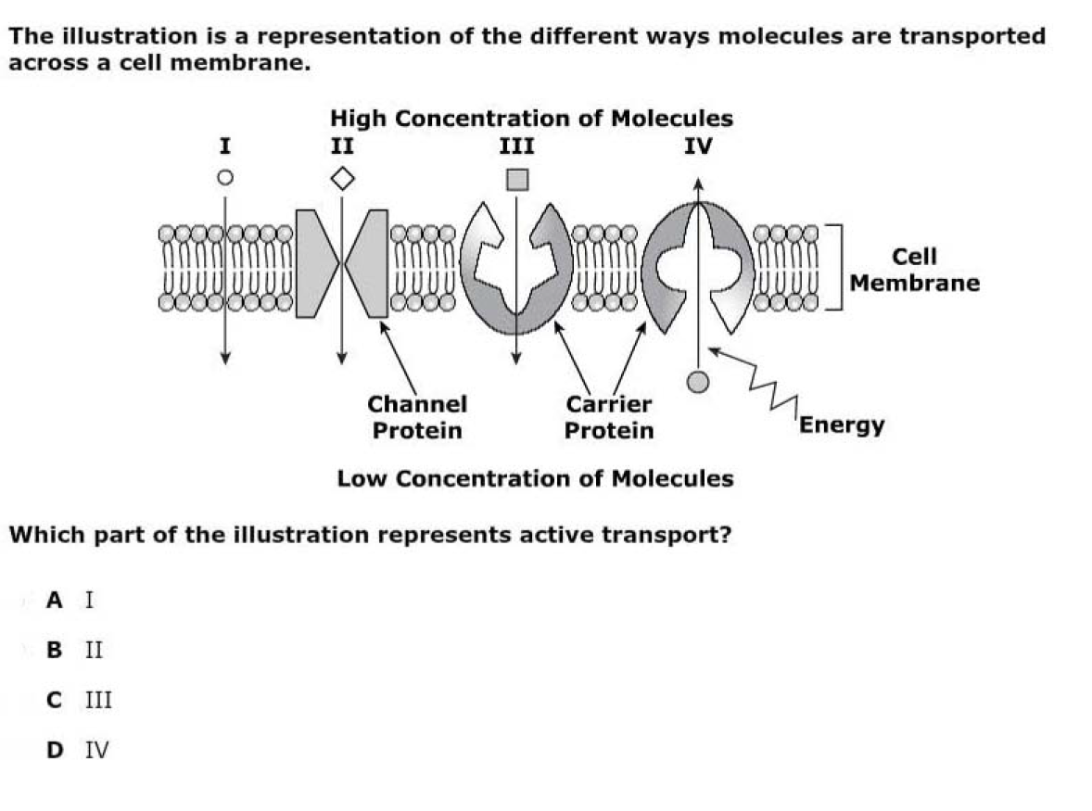
CFU
[Default]
[MC Any]
[MC All]
Notes:
D

Slide 7
High Order Thinking
Q1: If a cell were exposed to a poison that blocked the cell’s ability to manufacture ATP, what effect would that have on the cell membrane’s transport processes?
Q2: During intense exercise, POTASSIUM (K+) tends to accumulate in the fluid SURROUNDING muscle cells. What membrane protein helps muscle cells COUNTERACT this tendency? Explain how this works.
Q3: What would happen if the cell were exposed to a
drug that disabled the transport proteins in the
cell membrane?
Notes:
Q1 answer: All active transport processes would stop, because they require the cell to expend energy and ATP is the main energy currency of the cell. All passive transport processes would continue until the concentration gradient disappeared.
Q2 answer: The sodium-potassium pump counteracts the accumulation of potassium outside cells by transporting potassium into the cells in exchange for sodium.
Q3 answer: Transport by simple diffusion, osmosis, endocytosis, and exocytosis will still take place, but any transport requiring membrane proteins would not, for example facilitated diffusion and the sodium potassium pumps.

Slide 8
High Order Thinking Answers
Q1 answer: All active transport processes would stop, because they require the cell to expend energy and ATP is the main energy currency of the cell. All passive transport processes would continue until the concentration gradient disappeared.
Q2 answer: The sodium-potassium pump counteracts the accumulation of potassium outside cells by transporting potassium into the cells in exchange for sodium.
Q3 answer: Transport by simple diffusion, osmosis, endocytosis, and exocytosis will still take place, but any transport requiring membrane proteins would not, for example facilitated diffusion and the sodium potassium pumps.

Slide 9
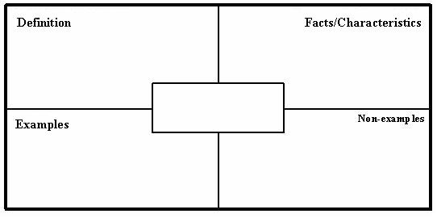
Closure
Create a Frayer Model for Active Transport and one for Passive Transport.

Slide 10
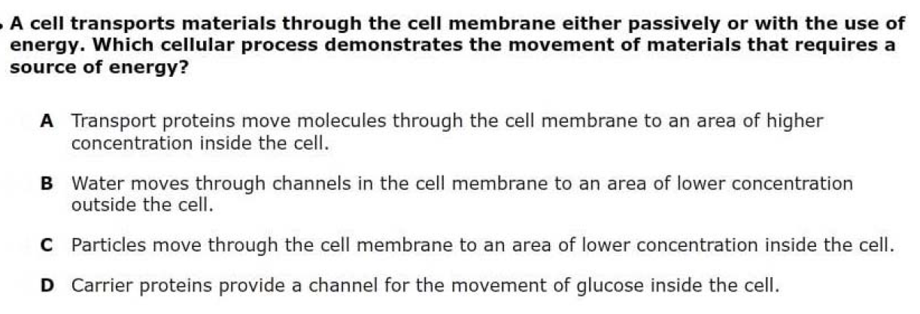
[Default]
[MC Any]
[MC All]
Do Now 02.02.16: Claim: ________________________________
is the cellular process that demonstrates the movement of materials that requires a source of energy.
Notes:
A

Slide 11
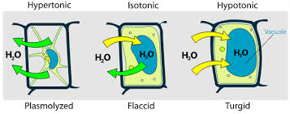
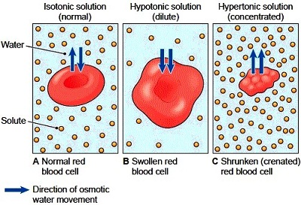
Osmosis Why is this important?

Slide 12
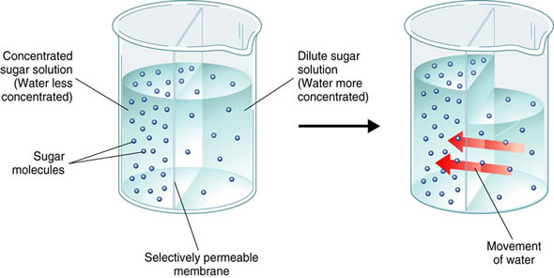
Osmosis (i.e., diffusion of WATER)
WATER moves from LOW [OAS] to HIGH [OAS]
NOTE: OAS: Osmotically Active Substance (a solute); salts, sugars, or proteins.

Slide 13
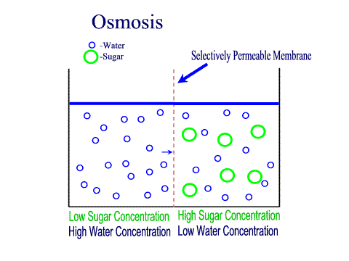
Osmosis is the diffusion of water through a selectively permeable membrane like the cell membrane
Water diffuses across a membrane from an area of high concentration to an area of low concentration.
Semi-permeable membrane is permeable to water, but not to sugar

Slide 14
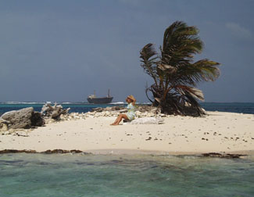
Critical Thinking
Sea water has a HIGHER concentration of SOLUTES than do human body cells. Why might drinking large amounts of SEA WATER be DANGEROUS for the human body’s equilibrium?

Slide 15
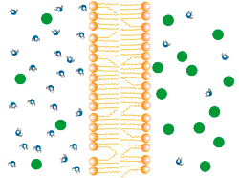

Slide 16
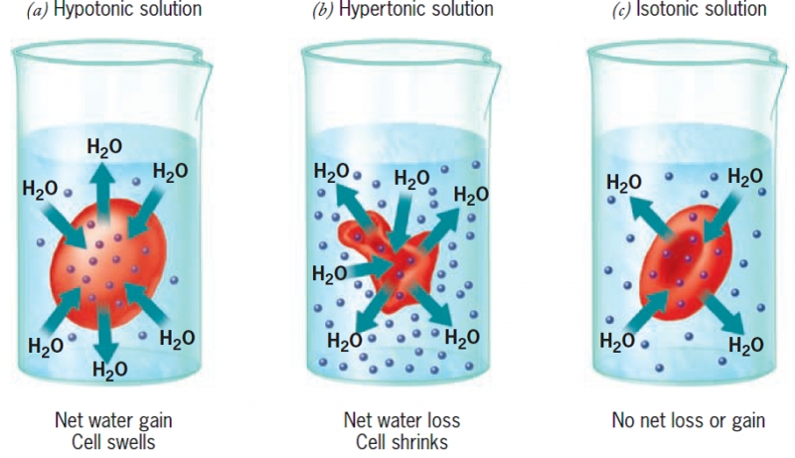
Water moves towards where there is LESS water.
Use the textbook to define hypertonic solution, hypotonic solution, and isotonic solution on your worksheet.
Draw what’s happening to the animal cells in each beaker in the appropriate place on your sheet.

Slide 17
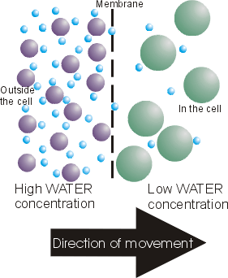

Slide 18
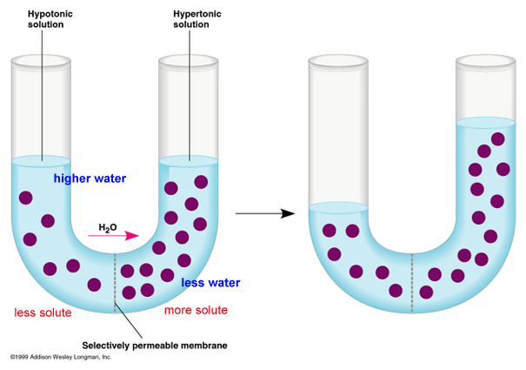

Slide 19
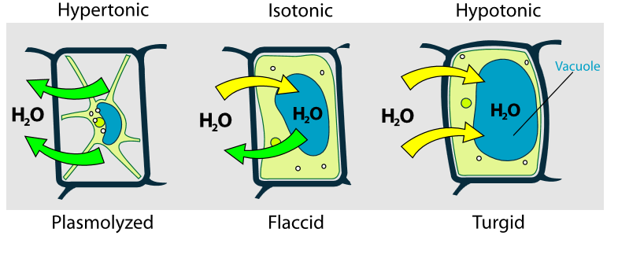
Plant Cells
Notes:
Hypertonic - When a plant cell is placed in a hypertonic solution, the water inside the cells are drawn out by osmosis. The vacuoles decrease in size. The cytoplasm also shrinks away from the cellulose cell wall and plasmolysis occurs. This causes a lack of structure for the plant and causes it to wilt, or become flaccid.
Hypotonic - When plants are placed in water, the water enters their cells (this is because their sap has a strong solution). The water enters the plant through osmosis and fills up the cell with water to its maximum capacity. A strong cell wall stops the cells from bursting (as in animal cells) and makes the plant to become turgid (becomes rigid/stiff because of water.)
Isotonic - osmotic pressure becomes equal; the force of water trying to exit and enter the cell balances out."ISO" means the same meaning that the osmotic pressure and concentration of solutes is the same in both the internal and external environments of the cell. Cells isotonic to their surrounding solutions have an equal concentration of solutes in and out of the cell membrane. This creates a dynamic equilibrium that maintains the status of the cell. No change will occur in the cell.

Slide 20
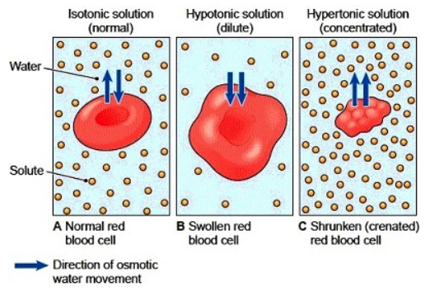
Animal Cells - Revisited

Slide 21
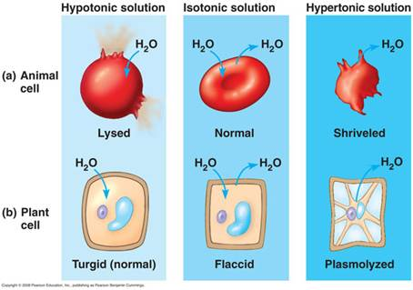
Animal vs Plant Cells

Slide 22
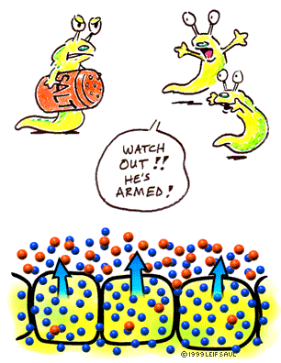
How Cells DEAL With Osmosis
Too much salt OR too little salt can be fatal for cells.

Slide 23
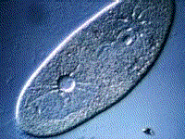
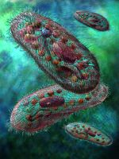
Contractile Vacuoles (found in freshwater protists)
Collects and PUMPS out EXCESS water using energy. (i.e., NOT osmosis, pumping AGAINST gradient)

Slide 24
Discussion 10 mins
Your group has 5 mins to formulate an answer to your question. You must be able to give a complete response within 1 min. Everyone must be able to answer because you don’t know who I will call.
What part of the plant cell keeps it from bursting due to osmotic pressure? Why?
After a family picnic, Ella dumped the ice and rock salt from the ice cream maker in the back yard. That area of yard now contains dead, brown grass. Explain why this happened, and use the words hypotonic, hypertonic, and plasmolysis in your explanation.
Using your understanding of plasmolysis and osmosis, explain why grocery stores frequently spray the produce and vegetables with a fine mist of water.
If a bowl of fresh strawberries is sprinkled with sugar, a few minutes later the berries will be covered with juice. Why?

Slide 25
Independent Practice: Diffusion and Osmosis Practice Worksheet
Use chapter 7 pages 201-205 for support.

Slide 26
Closure 5 mins
Rate your level of understanding.
Then, reflect on …..
Why do goldfish die if placed into a salt water environment?
Why do snails seem to dissolve when salt is poured on them?
Use key vocabulary related to osmosis to explain.
Notes:
http://www.todayifoundout.com/index.php/2014/03/skin-wrinkles-water/
http://scienceline.ucsb.edu/getkey.php?key=1987
http://www.kitsforkids.com/blog/2011/01/why-cant-saltwater-fish-live-in-fresh-water/

Slide 27
How Osmosis Works
How Osmosis Works
http://highered.mheducation.com/sites/0072495855/student_view0/chapter2/animation__how_osmosis_works.html
Osmosis / Plasmolysis
http://highered.mheducation.com/sites/9834092339/student_view0/chapter38/animation_-_osmosis.html
Hemolysis & Crenation
http://highered.mheducation.com/sites/0072495855/student_view0/chapter21/animation__hemolysis_and_crenation.html

