Slide 1
Do Now 10.20.17 - Complete in back of your comp.
Using your knowledge of word parts, explain what you think biodiversity means.
What is extinction?
_____________________________________________
Write on your guided Cornell Notes.
Learning Objective:
I can describe the concepts of biodiversity and its importance.
Essential Question: What is biodiversity?

Slide 2
Test Question Revisited
An energy pyramid is shown below.
How much energy consumed by the worm is available to the frog? A. 0.1% B. 1.0% C. 100% D. 10%
Hawk
Frog
Worm
Grass

Slide 3
Test Question Revisited
An energy pyramid is shown below.
How much energy consumed by the worm is available to the frog? A. 0.1% B. 1.0% C. 100% D. 10%
Hawk
Frog
Worm
Grass

Slide 4
Study Jams Biomes Video
Notes:
https://www.youtube.com/watch?v=91XG5v1b2zQ&list=PLLN0YgOcynhHmqle_kN3FAsIuraVj0LZP

Slide 5
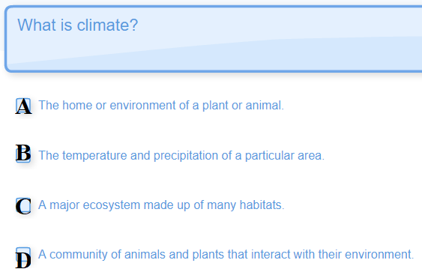
Question 1

Slide 6
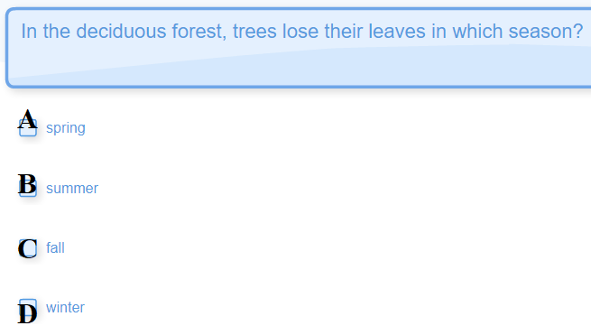
Question 2

Slide 7
Question 3
Which is the largest land biome?
Taiga
Desert
Tropical Rainforest
Deciduous Forest
Notes:
TAIGA

Slide 8
Question 4
Which is the largest biome in the biosphere?
Notes:
MARINE

Slide 9
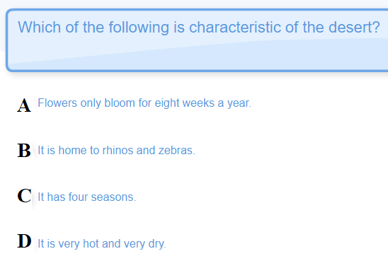
Question 5
Notes:
D

Slide 10
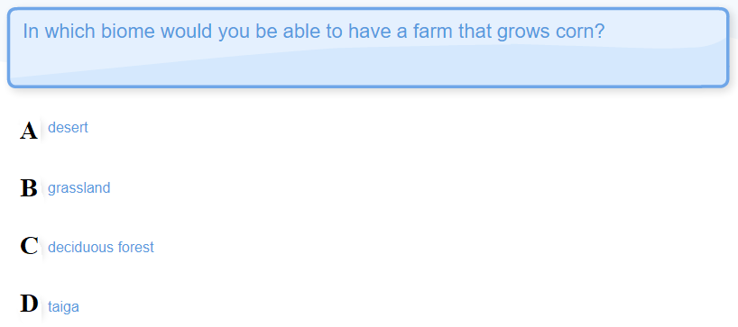
Question 6
Notes:
B

Slide 11
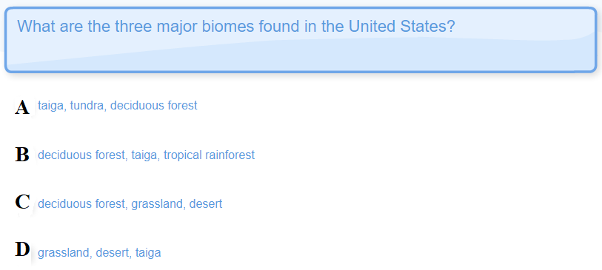
Question 7
Notes:
C

Slide 12
Biomes of the World
Notes:
https://www.youtube.com/watch?v=0fb8143ndo8
https://www.youtube.com/watch?v=iIQS8kb1wg4 Biomes Our Earth s Major Life Zones (fixed)

Slide 13
Biomes Video Post-assessment
The largest biome in the world is the __________ biome.
Name a freshwater biome.
Most animals in the arctics get their food from the ________.
Which biome has permafrost?
Deserts are very ________.

Slide 14
Biomes EOC and CA Review Questions
Now Let’s Look at Biomes EOC and CA Review Questions

Slide 15
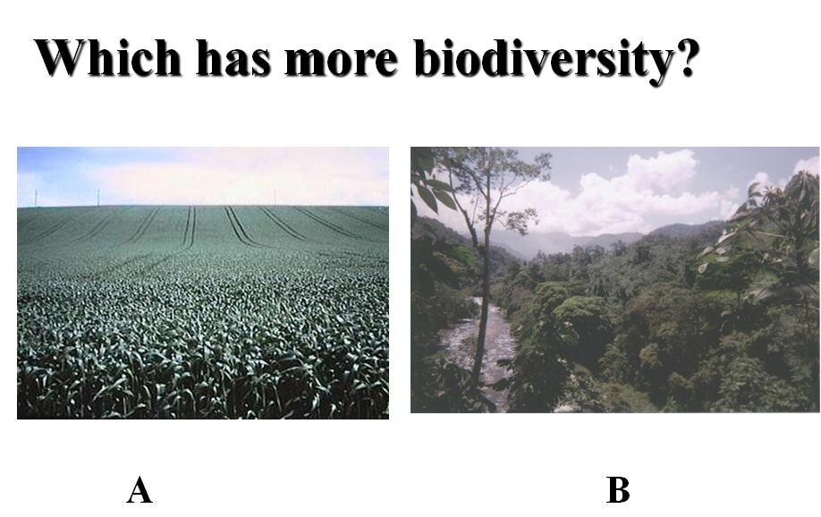

Slide 16
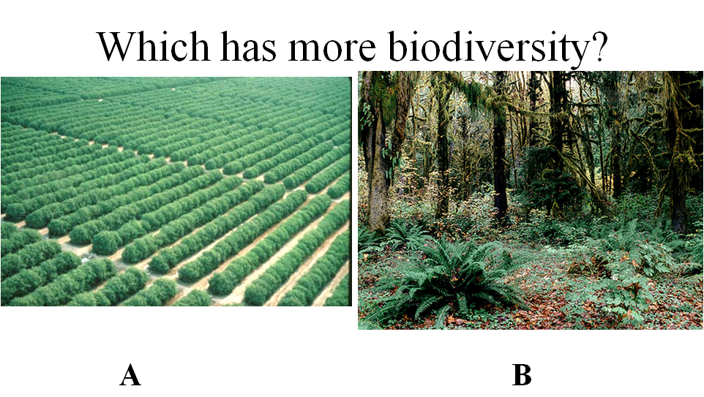

Slide 17
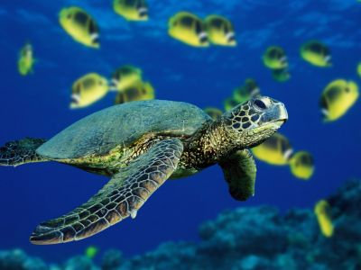
Biodiversity
Copyright Pearson Prentice Hall
Notes:
‹#›
© Sun Star/Stock Photos Hawaii

Slide 18
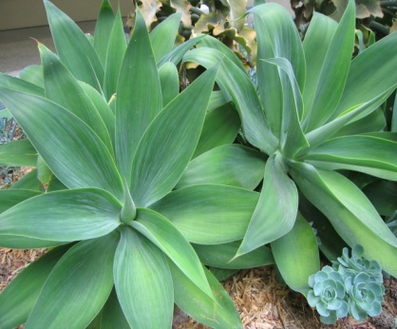
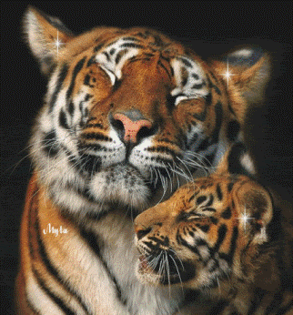
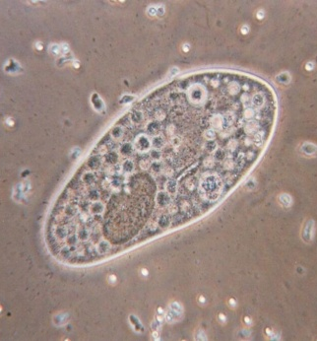
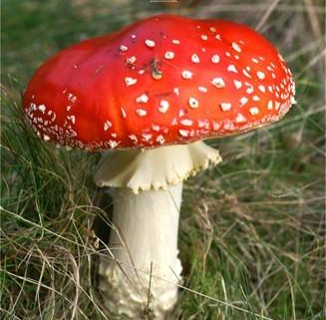
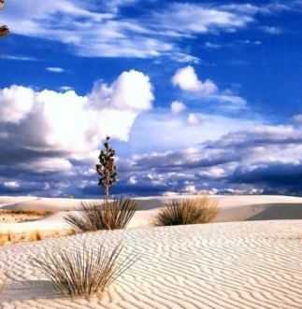
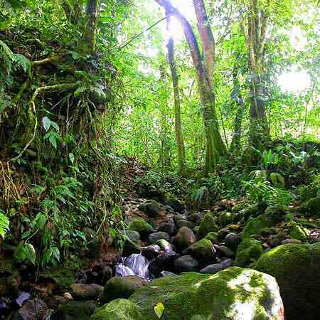
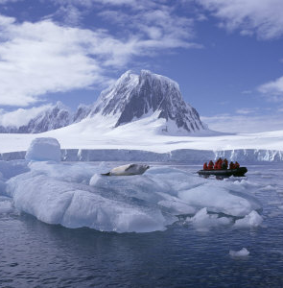
The Value of Biodiversity
Biodiversity
All the different forms of life and
the different ecosystems they inhabit
Notes:
‹#›

Slide 19
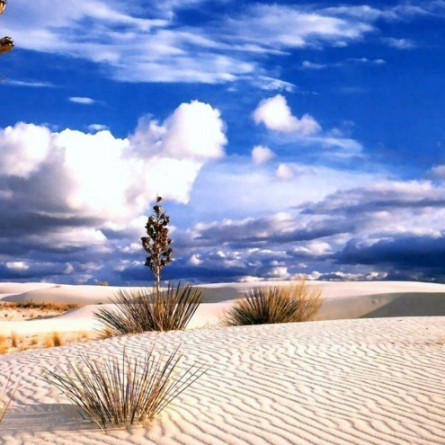
The Value of Biodiversity
Ecosystem Diversity
The variety of ecosystems that exist
in the living world
Notes:
‹#›

Slide 20
Ecosystem Diversity
Check For Understanding
Think of different types of ecosystems.
Write down at least 2 types of ecosystems.
Discuss how this shows ecosystem diversity.

Slide 21
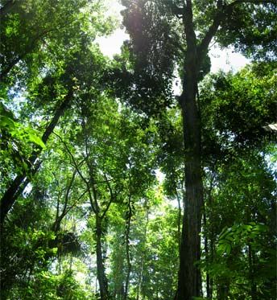
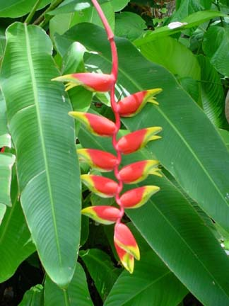
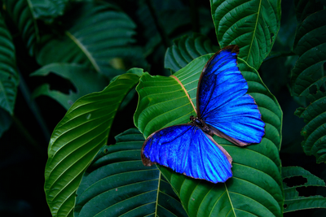
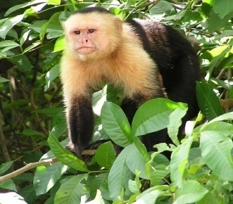
The Value of Biodiversity
Species Diversity
The variety of species
that live in an ecosystem
Notes:
‹#›

Slide 22
Species Diversity
Check For Understanding
Think of different types of species living in the ocean.
Write down at least 4 different oceanic species.
Discuss how this shows species diversity.

Slide 23
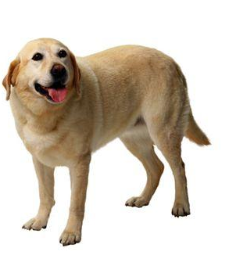
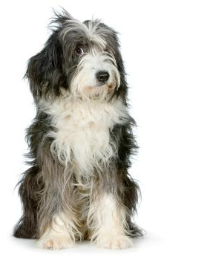
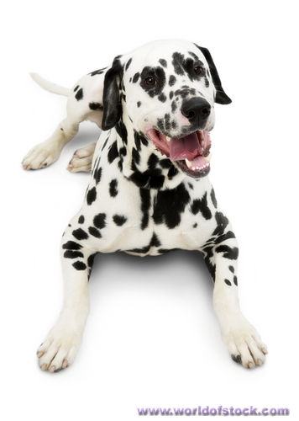
The Value of Biodiversity
Genetic Diversity
Variation within a species
Notes:
‹#›
These are all dogs – members of the same species.

Slide 24
The Value of Biodiversity
Note: Species diversity is NOT the same as genetic diversity.
Copyright Pearson Prentice Hall
Notes:
‹#›
Species diversity is even more specific. It refers to the number of different species in an ecosystem. Some ecosystems, such as tropical rainforests, have higher species diversity than others. These are all organisms from the rainforest of northeastern Costa Rica, which has very high species diversity. Strawberry Poison-Dart Frog (Ranita Roja), Heliconia (Plantanillo) – a member of the banana family, the famous Blue Morpho butterfly (Morpho azul), and the White-faced capuchin (Carita Blanca).

Slide 25
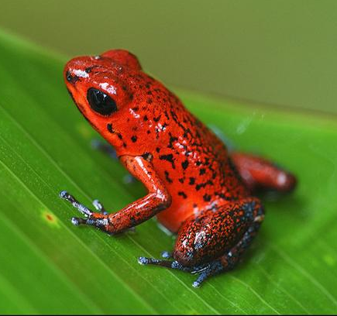
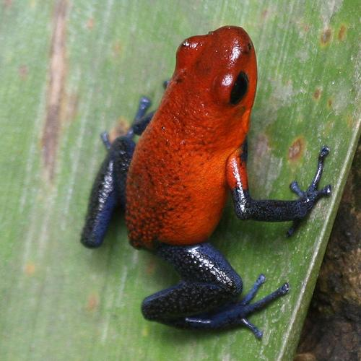
The Value of Biodiversity
Note: species diversity is NOT the same as genetic diversity. Genetic diversity is more specific.
Copyright Pearson Prentice Hall
Notes:
‹#›
Species diversity is even more specific. It refers to the number of different species in an ecosystem. Some ecosystems, such as tropical rainforests, have higher species diversity than others. These are all organisms from the rainforest of northeastern Costa Rica, which has very high species diversity. Strawberry Poison-Dart Frog (Ranita Roja), Heliconia (Plantanillo) – a member of the banana family, the famous Blue Morpho butterfly (Morpho azul), and the White-faced capuchin (Carita Blanca).

Slide 26
Check for Understanding Partner Activity
Using the list of major land biomes and your assigned biome from pages 68-72 in the textbook, give specific examples of each.
Ecosystem Diversity
Species Diversity
Genetic Diversity
You will have 5 minutes to discuss with your partner and write a response. Be prepared to report out to the group. Decide who will explain your responses to the class.
Notes:
Create 5 sets of cards with the biome names.

Slide 27
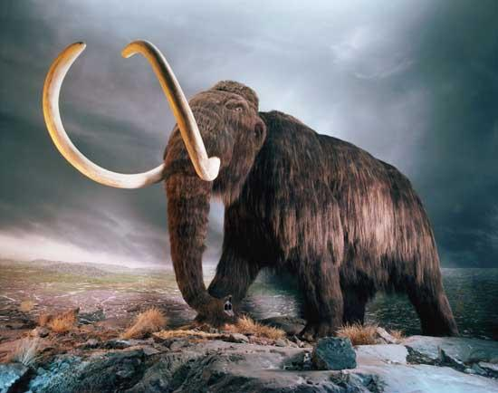
The Value of Biodiversity
Extinction
When a species disappears
from part (or all) of its range
Notes:
‹#›

Slide 28
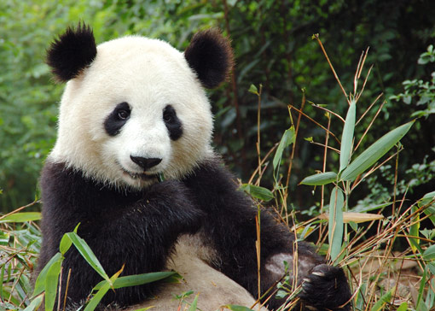
The Value of Biodiversity
Endangered Species
A species whose population size
is decreasing (DR > BR)
Notes:
‹#›

Slide 29
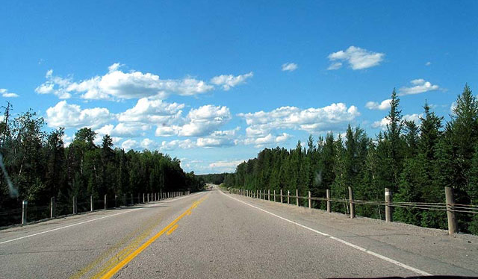
The Value of Biodiversity
Habitat Fragmentation
When urban development splits an ecosystem
(ex: highway that cuts through a forest)
Notes:
‹#›

Slide 30
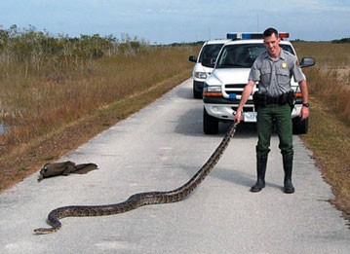
The Value of Biodiversity
Invasive Species
Non-native species
introduced into a new habitat
Notes:
‹#›
Often happens when people release their pets into the wild.

Slide 31
The Value of Biodiversity
Why is genetic diversity important?
Copyright Pearson Prentice Hall
Notes:
‹#›

Slide 32
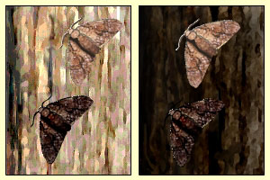
The Value of Biodiversity
Genetic diversity prevents extinction.
Copyright Pearson Prentice Hall
Notes:
‹#›

Slide 33
The Value of Biodiversity
Why is biodiversity important?
Copyright Pearson Prentice Hall
Notes:
‹#›

Slide 34
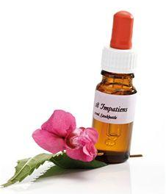
The Value of Biodiversity
Biodiversity is a natural resource. Species of many kinds provide us with foods, materials, and medicines.
Copyright Pearson Prentice Hall
Notes:
‹#›

Slide 35
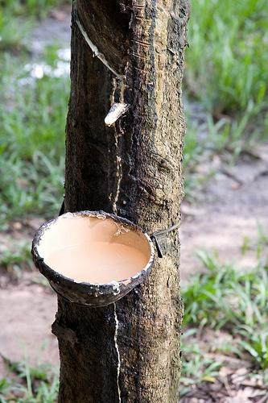
The Value of Biodiversity
This is a rubber tree. Spanish: Castilla elastica. Its sap, known as latex, gives us natural rubber. Without it, would could not have made tires or cars.
Copyright Pearson Prentice Hall
Notes:
‹#›
This is a rubber tree. Spanish: Castilla elastica. Its sap, known as latex, gives us natural rubber. Without it, would could not have made tires or cars.

Slide 36
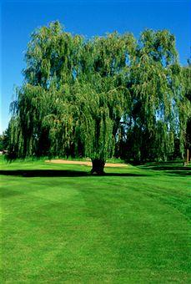
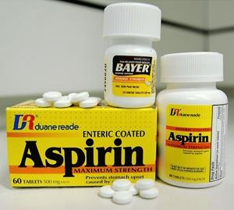
The Value of Biodiversity
Aspirin, a painkiller, is made from willow bark, a type of tree.
Copyright Pearson Prentice Hall
Notes:
‹#›
Aspirin, a painkiller, is made from willow bark, a type of tree.

Slide 37
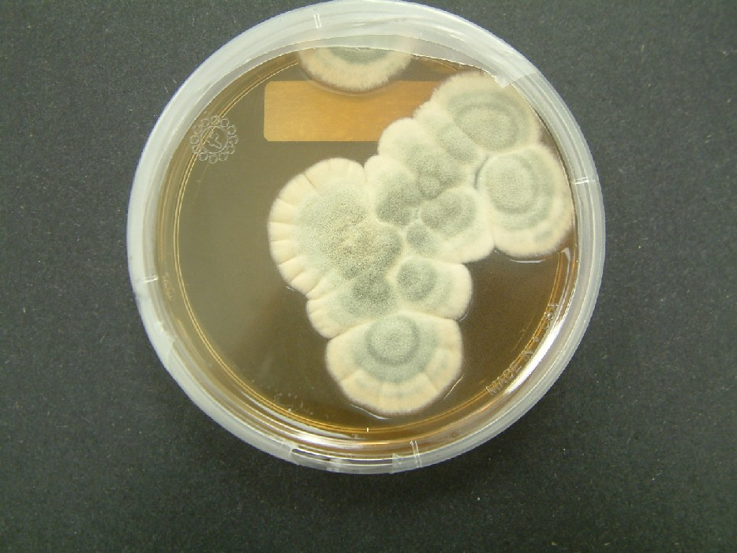
The Value of Biodiversity
What is penicilin? Penicilin is a substance produced by a fungus. Amazingly, this substance destroys harmful bacteria. Literally millions of lives have been saved because of this fungus and the substance it produces.
Copyright Pearson Prentice Hall
Notes:
‹#›
What is penicilin? Penicilin is a substance produced by a fungus. Amazingly, this substance destroys harmful bacteria. Literally millions of lives have been saved because of this fungus and the substance it produces.

Slide 38
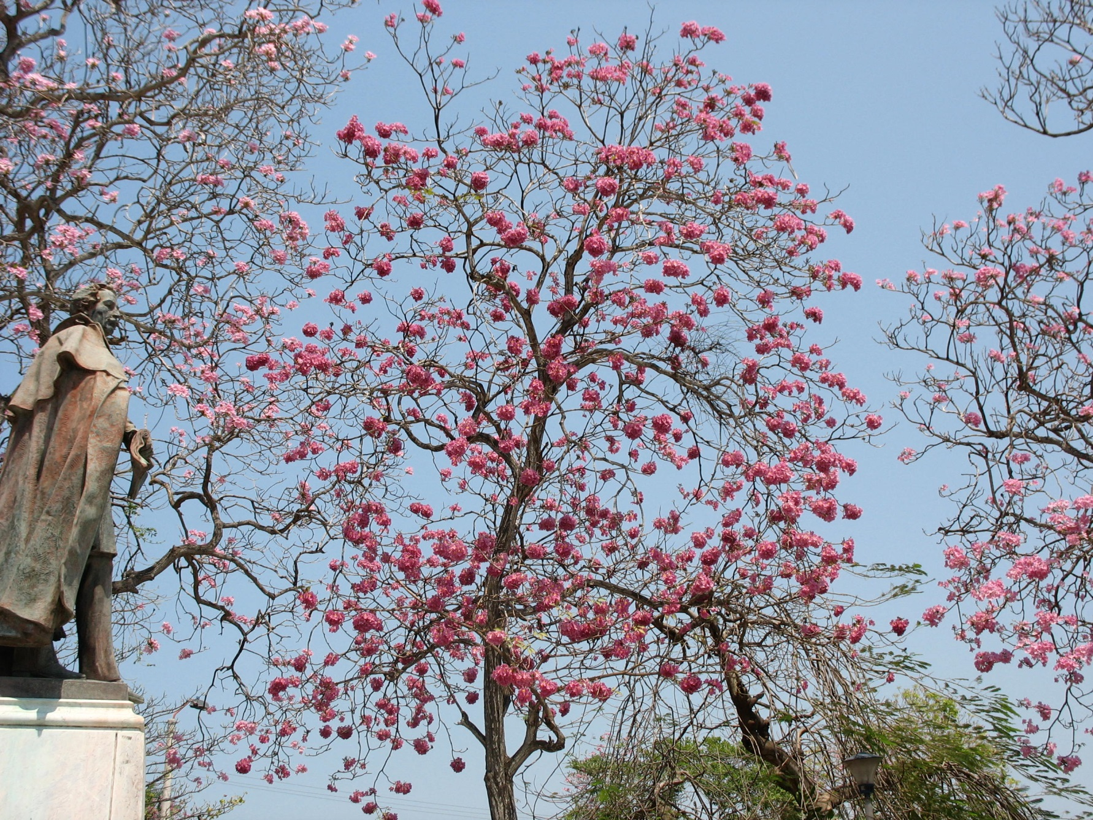
The Value of Biodiversity
There are over 1.5 million different species of living things on Earth.
Can you imagine what we haven’t discovered yet?
Drug companies are racing to test different plants that grow in the rainforest.
What do you think they’re looking for?
They are hoping to find a “miracle drug,” perhaps a cure for cancer. One tree that researcher are looking at now is Roble de Sabanah (Savannah Oak), the national tree of El Salvador. The people of Central America have known for years that this is a special tree. The bark is used to cure parasites, and the leaves are used to cure cancer.
Copyright Pearson Prentice Hall
Notes:
‹#›
There are over 1.5 million different species of living things on Earth. Can you imagine what we haven’t discovered yet? Drug companies are racing to test different plants that grow in the rainforest. What do you think they’re looking for? They are hoping to find a “miracle drug,” perhaps a cure for cancer. One tree that researcher are looking at now is Roble de Sabanah (Savannah Oak), the national tree of El Salvador. The people of Central America have known for years that this is a special tree. The bark is used to cure parasites, and the leaves are used to cure cancer.

Slide 39
Threats to Biodiversity
What are the current threats to biodiversity?
Prior Knowledge Check
Copyright Pearson Prentice Hall
Notes:
‹#›

Slide 40
Threats to Biodiversity
Threats to Biodiversity
Human activity can reduce biodiversity by:
Habitat alteration (ex: habitat fragmentation)
Pollution (ex: DDT in the food web)
Introduction of invasive species into new ecosystems
Copyright Pearson Prentice Hall
Notes:
‹#›

Slide 41
Threats to Biodiversity
A decrease in biodiversity can be measured by the number of species that have gone extinct in an area.
10 most amazing extinct animals
Copyright Pearson Prentice Hall
Notes:
‹#›

Slide 42
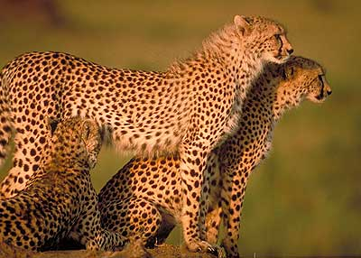
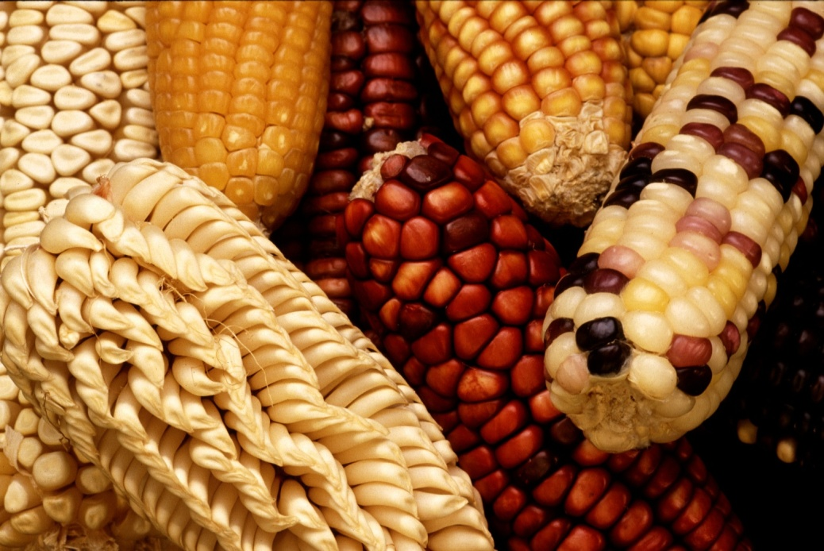
Threats to Biodiversity
The more genetic diversity within a species, the more resistant it will be to extinction. Diversity = survival!
Copyright Pearson Prentice Hall
Notes:
‹#›
The cheetah is an endangered species. There are only about 7000 cheetahs left, mostly in the country of Namibia, in Africa.

Slide 43
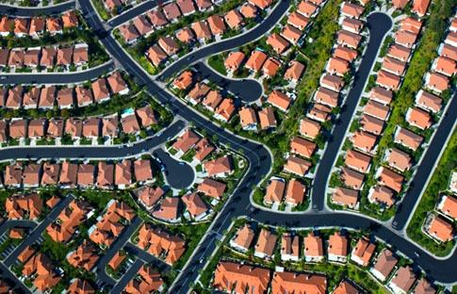
Habitat Alteration
Habitat Alteration
When urban areas develop, natural habitats are destroyed.
Copyright Pearson Prentice Hall
Notes:
‹#›
A typical suburb shown from above, where a natural habitat used to be.

Slide 44
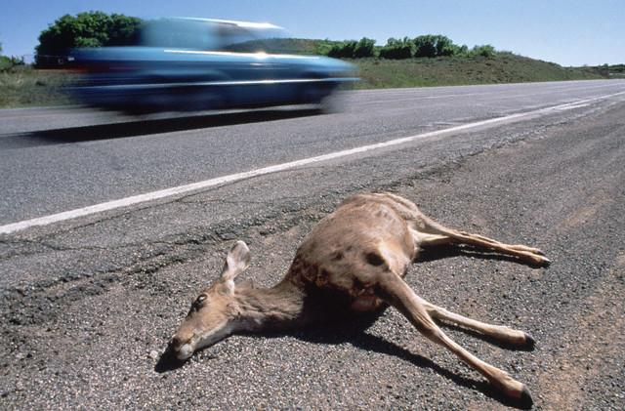
Habitat Alteration
Species extinction occurs most quickly in smaller ecosystems, since smaller ecosystems cannot support as much biodiversity. Diversity = survival!
Copyright Pearson Prentice Hall
Notes:
‹#›
A smaller ecosystem cannot support as much biodiversity as a large ecosystem, because it does not have as many resources. Habitat fragmentation can therefore lead to species extinction.

Slide 45
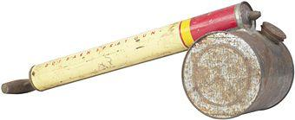
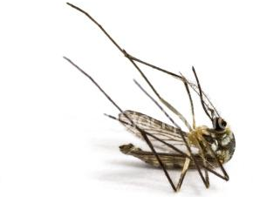
Pollution
Pollution
Many forms of pollution can threaten biodiversity.
DDT, one of the first pesticides, is a good example of this.
Copyright Pearson Prentice Hall
Notes:
‹#›
DDT was initially created to kill mosquitoes. At the time, malaria was a major problem in many parts of the world. Since malaria is carried by mosquitoes, it was thought that DDT would eliminate malaria by killing all the mosquitoes. And that’s exactly what it did – at first.

Slide 46
Pollution
For a long time, DDT was considered harmless. However, DDT has two hazardous properties:
It is non-biodegradable (cannot be broken down by organisms.)
Once DDT is picked up by organisms, it cannot be eliminated from their bodies. It is passed along the food chain as the organisms are eaten.
Copyright Pearson Prentice Hall
Notes:
‹#›
DDT is not a natural compound. It was created by scientists in a laboratory. As a result, it is not biodegradable – that is, it cannot be broken down by organisms.

Slide 47
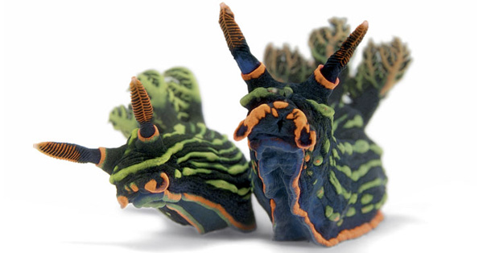
Introduced Species
Introduced Species
Another threat to biodiversity comes from plants and animals that humans bring into new ecosystems either accidentally or on purpose.
Invasive species reproduce rapidly because their new habitat lacks the predators that would normally control their population.
Copyright Pearson Prentice Hall
Notes:
‹#›
How many of you have traveled outside of the US? When you come back, you have to go through customs. What do the customs officials always ask you? Are you carrying any fruits or vegetables? The reason they ask this is because they are trying to prevent the accidental transport of invasive species.

Slide 48
Check for Understanding/Exit Ticket Number 1-5 You must commit to an answer.

Slide 49
6-3
The type of biodiversity that includes the inheritance information carried by the Earth’s organisms is called
biological magnification.
ecological diversity.
genetic diversity.
species diversity.
Copyright Pearson Prentice Hall
Notes:
‹#›

Slide 50
6-3
Populations of invasive species tend to
decrease.
increase rapidly.
remain constant.
increase, then decrease.
Copyright Pearson Prentice Hall
Notes:
‹#›

Slide 51
6-3
The wise management of natural resources, including the preservation of habitats and wildlife, is known as
biodiversity.
conservation.
habitat alteration.
ecosystem diversity.
Copyright Pearson Prentice Hall
Notes:
‹#›

Slide 52
6-3
By focusing on protecting specific ecosystems, biologists hope to preserve
global biodiversity.
biological magnification.
invasive species.
habitat fragmentation.
Copyright Pearson Prentice Hall
Notes:
‹#›

Slide 53
6-3
In a food pyramid, biological magnification results in the
increased amount of a toxic substance in organisms at the lowest level.
increased amount of a toxic substance in organisms at the highest level.
decreased number of levels in the food pyramid.
increased amount of a toxic substance in the surrounding air or water.
Copyright Pearson Prentice Hall
Notes:
‹#›

Slide 54
6-3
The type of biodiversity that includes the inheritance information carried by the Earth’s organisms is called
biological magnification.
ecological diversity.
genetic diversity.
species diversity.
Copyright Pearson Prentice Hall
Notes:
‹#›

Slide 55
6-3
Populations of invasive species tend to
decrease.
increase rapidly.
remain constant.
increase, then decrease.
Copyright Pearson Prentice Hall
Notes:
‹#›

Slide 56
6-3
The wise management of natural resources, including the preservation of habitats and wildlife, is known as
biodiversity.
conservation.
habitat alteration.
ecosystem diversity.
Copyright Pearson Prentice Hall
Notes:
‹#›

Slide 57
6-3
By focusing on protecting specific ecosystems, biologists hope to preserve
global biodiversity.
biological magnification.
invasive species.
habitat fragmentation.
Copyright Pearson Prentice Hall
Notes:
‹#›

Slide 58
6-3
In a food pyramid, biological magnification results in the
increased amount of a toxic substance in organisms at the lowest level.
increased amount of a toxic substance in organisms at the highest level.
decreased number of levels in the food pyramid.
increased amount of a toxic substance in the surrounding air or water.
Copyright Pearson Prentice Hall
Notes:
‹#›

Slide 59
Importance of Biodiversity Partner Assignment
complete in your composition
Students, read The Importance of Biodiversity p.118-121 and
Do
Reading Check p.119
Figure 5.7 Infer p.120
Understanding Main Ideas p.121 # 3
Understanding Main Ideas p.121 # 4
Understanding Main Ideas p.121 # 5

Slide 60
Closure
Write 3 sentences reflecting on today’s discussion. Use the sentence starters that are provided.
Biodiversity is …
Threats to biodiversity include ...
Biodiversity is important because …
How well do you understand biodiversity?

Slide 61
END OF SECTION
Notes:
‹#›

