Slide 1
Do Now 9.22.14
What are some observations you can make about populations of insects over the course of a year?

Slide 2
Population Ecology

Slide 3
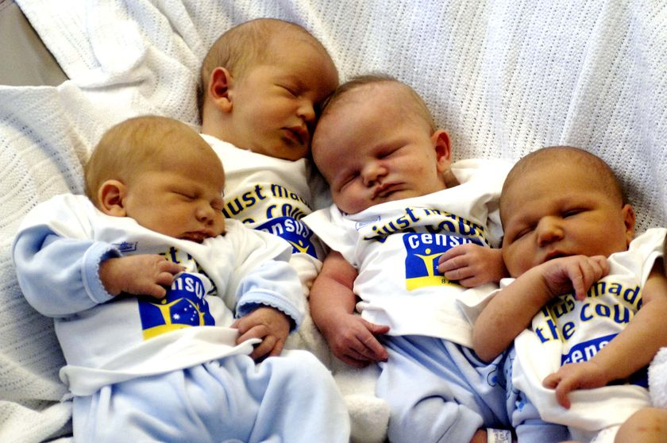
1. Birth Rate
Birth Rate (natality rate)= number of babies being born per unit time
Examples: 23 births / year (twenty three births per year)
10 births / minute (ten births per minute)

Slide 4
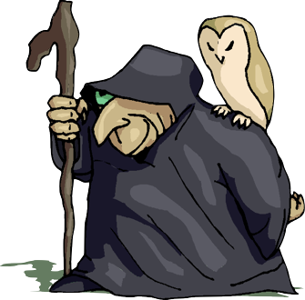
2. Death Rate
Death Rate (mortality)= Number of individuals that die per unit time
Examples: 73 deaths / hour (seventy three deaths per hour)
5 deaths / second (five deaths per second)

Slide 5
3. Immigration and Emigration
Immigration = the number of individuals that move INTO a population
Immigration = Into a population
Emigration = the number of individuals that move FROM a population
Emigration = Exiting a population

Slide 6
How Many Individuals Are IN a Population
(Births + Immigrants) - (Deaths + Emigrants)
Lead to Population Growth
Lead to Population Decline

Slide 7
Population Growth

Slide 8
So What Determines the Size of a Population?

Slide 9
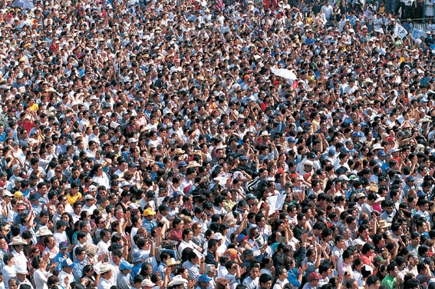
We call these...
LIMITING FACTORS
LIMITING FACTOR = Something that keeps a population from growing infinitely

Slide 10
THINKPAIRSHARE
What is keeping the human population from growing infinitely big?

Slide 11
5 MAJOR LIMITING FACTORS

Slide 12
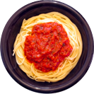
Limiting Factor #1
Resources
Food
Water

Slide 13
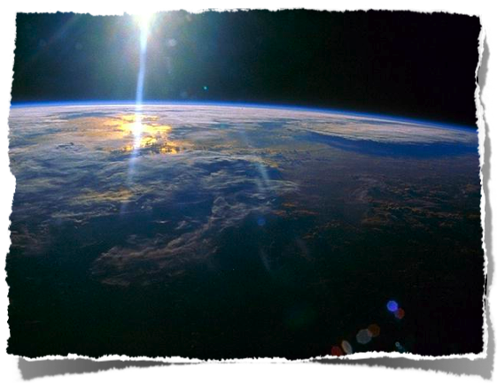
Limiting Factor #2
Space

Slide 14
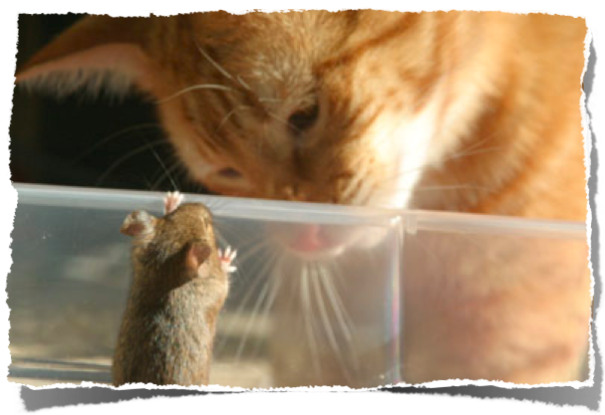
Limiting Factor #3
Predators

Slide 15
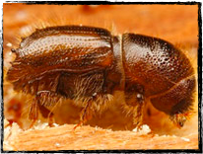
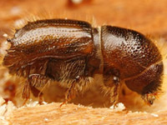
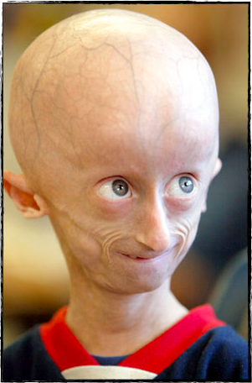
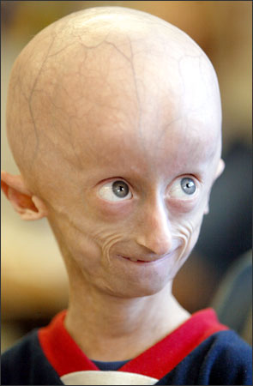
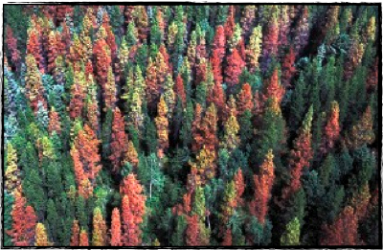
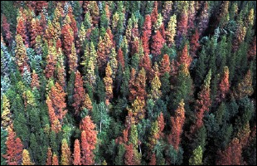
Limiting Factor #4
Disease
progeria
Bark Beetle

Slide 16
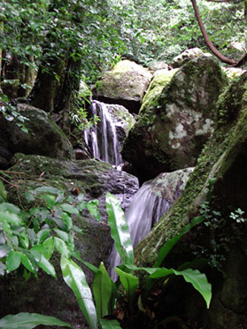
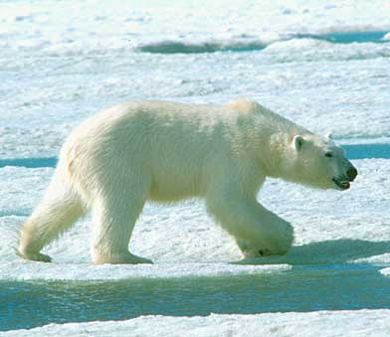
Limiting Factor #5
Habitat
?
NOPE!
Not the right Habitat (Home)

Slide 17
So now we know what limits a population from growing...Now let’s look at the different ways a population can grow

Slide 18
There are 2 different models:
1. Exponential Growth Model
2. Logistical Growth Model

Slide 19
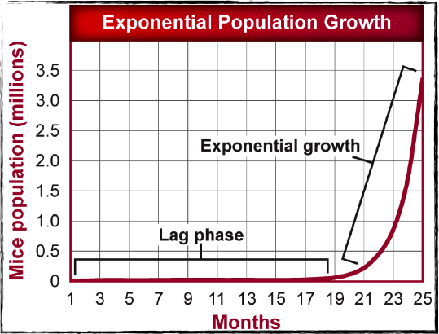
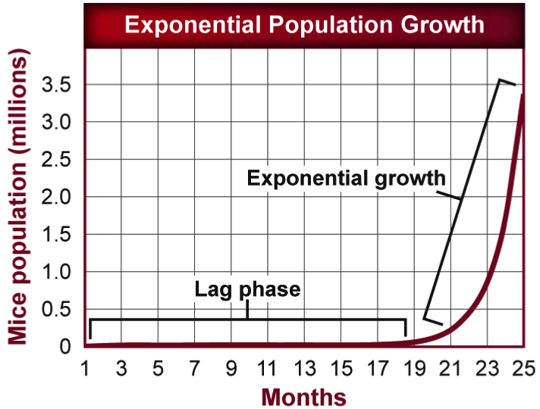
Exponential Growth
Resources are plentiful (there is a lot of food and water!)
All populations grow this way until some limiting factor stops them

Slide 20
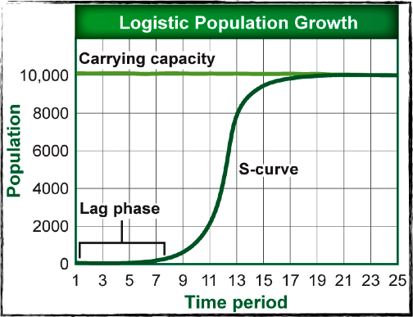
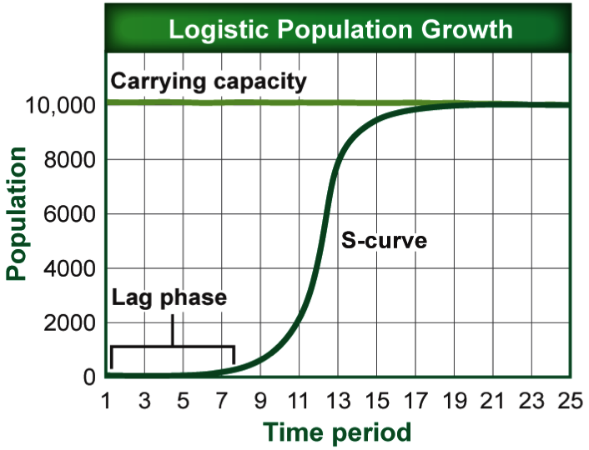
Logistical Growth Model
Limiting factors keep the population from growing exponentially
Logistical growth = Carrying Capacity

Slide 21
Carrying Capacity
Carrying Capacity = highest number of organisms an area can hold
- This is where the Logistical Growth Model flattens out at the top

Slide 22
What determines the Carrying Capacity?
LIMITING FACTORS!

Slide 23
What’s the Carrying Capacity Here?...
10,000 individuals = the highest number of individuals this area can hold

Slide 24
Check For Understanding
Does the population size decrease at the carrying capacity?
How can you tell?

Slide 25
Scenario #1
A prairie in Morgan Hill is home to a species of rabbits. The prairie is full of grass and the rabbits do not normally have to compete with any other organism for food. A group of scientists want to do an experiment on population growth, and introduce a new closely related species of rabbit into the prairie. The two rabbit species are now at competition for food. What will the growth model look like for the original population of rabbits that inhabited the prairie first?

Slide 26
Scenario #2
A deserted island in the Caribbean has a seemingly unlimited supply of fruits and vegetables and space for miles and miles. A ship passing by crashed and a bunch of monkeys jumped ship. What will the population growth model look like for this population of monkeys with unlimited space and food?

Slide 27
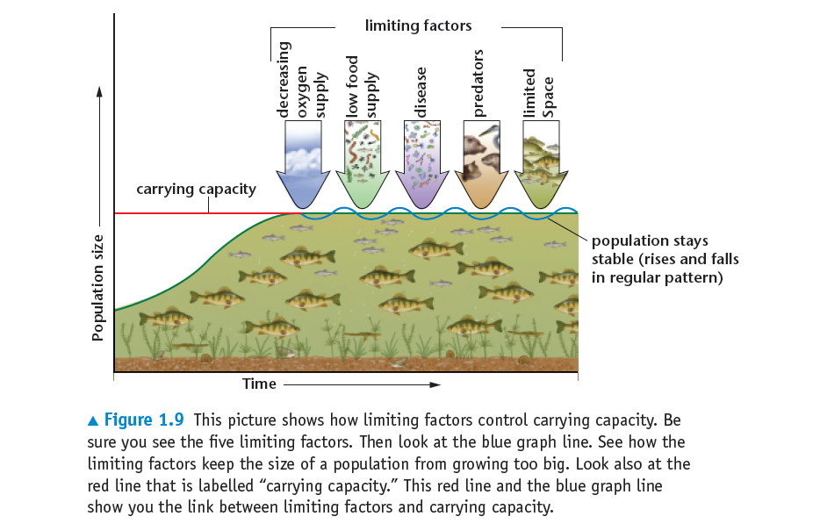

Slide 28
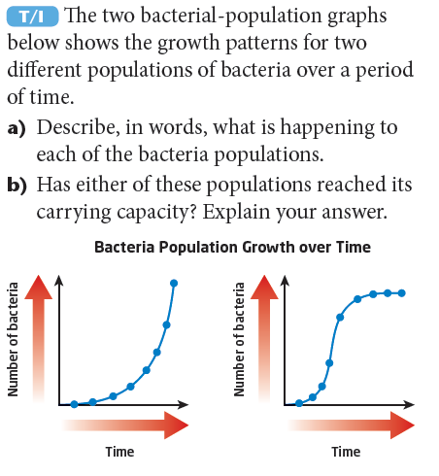
Quick
Write
5 mins

Slide 29
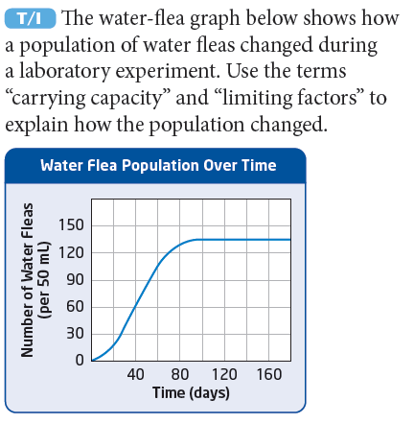
Quick
Write
5 mins

Slide 30
Think
Pair
Share

Slide 31
Closure
Summarize your learning for today in 5 sentences.
Explain 1 concept that you learned to a peer.
Homework: Read chapter 4.1 and define all highlighted vocabulary. On page 99 do section assessment questions 2,4 and 5.

