Slide 1
EVOLUTION
Learning Target: I can explain how genetic variation in a population and changing environmental conditions are associated with adaptation and the emergence of new species.
Standard: CLE 3210.5.4 Summarize the supporting evidence for the theory of evolution.
Why is this important?

Slide 2
DO NOW 10.24.16 or 10.25.16
Write the question.
Notes:
D, J

Slide 3
Evolution Video
Notes:
https://www.youtube.com/watch?feature=player_embedded&v=GhHOjC4oxh8
9 minutes

Slide 4
THEORY OF EVOLUTION
Evolution is defined as the cumulative change in a group of organisms over time.
Evolution is defined as the hereditary changes in groups of living organisms over time.
How is this shown in the previous picture?

Slide 5
CHARLES DARWIN
Charles Darwin is the scientist who developed the theory of evolution based on natural selection.
Why might this be considered a theory rather than a fact?
We will talk about natural selection in greater detail later in the lesson.

Slide 6
DEFINITION OF ADAPTATION
Adaptation- An inherited characteristic of a species that develops over time in the response to an environmental factor. This change must help the species better survive.
Break it down into your own words. (2 min)

Slide 7
GALAPAGOS ISLAND 3:26
Notes:
http://video.nationalgeographic.com/video/ecuador_galapagos
http://travelblog.goaheadtours.com/9-animals-youll-only-find-in-the-galapagos/
http://www.galapagosislands.com/galapagos-history/galapagos-evolution.html
https://www.probe.org/the-galapagos-islands-evolutions-sacred-ground/
http://www.amnh.org/exhibitions/lonesome-george/galapagos-tortoises-and-evolution/

Slide 8
CFU
Summarize what you understand about evolution and adaptations. (3 sentences minimum.)

Slide 9
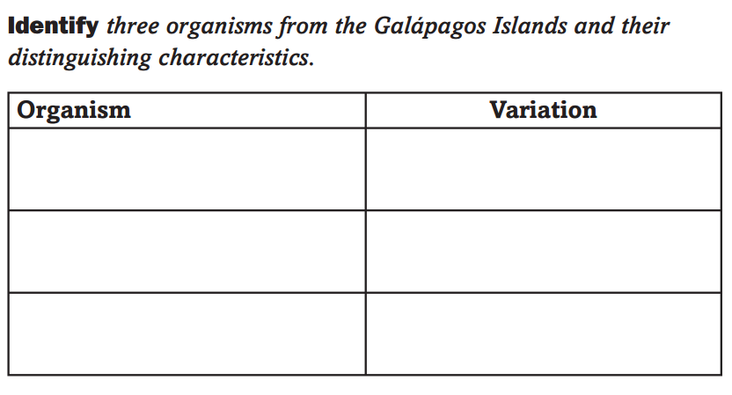
DO NOW
Define variation then complete the chart.

Slide 10
Echo Reading - Natural Selection p. 420 - Table 15.1 on p. 422
Write the second bullet under the Section Summary on page 422.

Slide 11
NATURAL SELECTION-A STORY
A species inherits a mutation (or different trait from the normal population) that allows it to better survive in its environment.
(webbed feet in a wet environment allows the animal to swim where others cannot)
This one individual thrives in the environment allowing it to reproduce-PASSING THE DESIRED TRAIT (mutation) to its offspring
The offspring now thrive in the environment allowing them to reproduce.
Individuals less suited to environment die off.

Slide 12
SURVIVAL OF THE FITTEST
Notes:
http://www.giraffeworlds.com/giraffe-evolution/

Slide 13
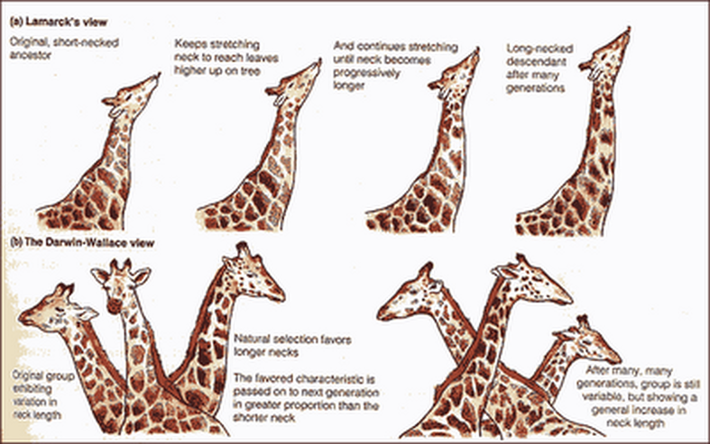
Lamarck vs. Darwin & Wallace

Slide 14
Natural Selection BrainPop
https://www.brainpop.com/science/cellularlifeandgenetics/naturalselection/
Login - username: bingwong
password: tigers

Slide 15
DO NOW 10.26.16 or 10.27.16
Place the following steps on evolution in the proper order. 3 mins
Organisms produce more offspring than can survive.
Over time offspring with helpful variations expand the population and can eventually become a separate species.
Differences in variations occur among individuals of a species.
Some variations are helpful and the individuals with helpful variations survive and reproduce.
Variations among parents are passed to offspring.
Notes:
3-5-1-4-2

Slide 16
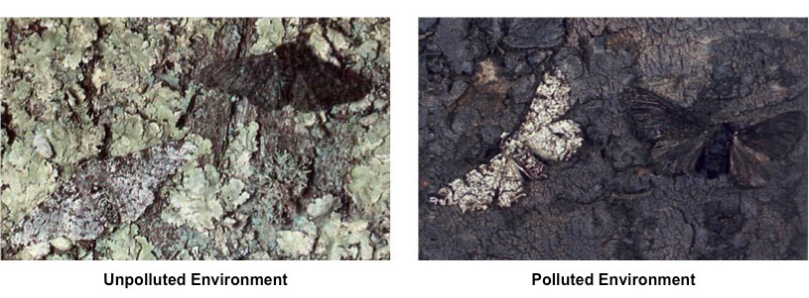

Slide 17
MOTH DEMO DISCUSSION
Discuss follow-up questions and the extension.
Online Peppered Moth Simulation
http://peppermoths.weebly.com/
Draw the table on your paper.
 | Percent Light Moths | Percent Dark Moths
Light Forest
Dark Forest
Notes:
http://biologycorner.com/worksheets/pepperedmoth.html

Slide 18
DO NOW 10.28.16
Think about the shape of different bird beaks. Explain how a bird’s beak could determine the types of food it can eat. Justify your answer with specific examples based on your prior knowledge and/cite evidence from page 864.

Slide 19
NATURAL VS ARTIFICIAL SELECTION
Artificial selection is the process of directed breeding to produce a desired trait (breeding a certain color dog)
Natural selection= survival of the fittest.
http://learn.genetics.utah.edu/content/selection/artificial/

Slide 20
DO NOW 10.31.16 or 11.01.16
Discuss with your partner why you choose your answer.
What evidence do you have to support your answer?

Slide 21
EVIDENCE FOR EVOLUTION
Fossil Record
What are fossils?
Fossil record shows us the structures of animals that are extinct for a comparison to the animals we have now.
Derived traits- Traits that do not appear in the fossils. Such as feathers.
Ancestral Traits- bones, teeth, nails.

Slide 22
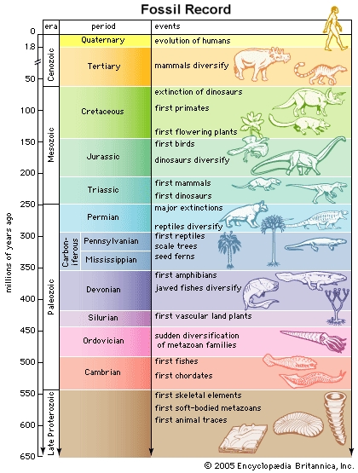
Newest fossils are found close to the surface.
Older fossils are deep below Earth’s surface.
What is this called?

Slide 23
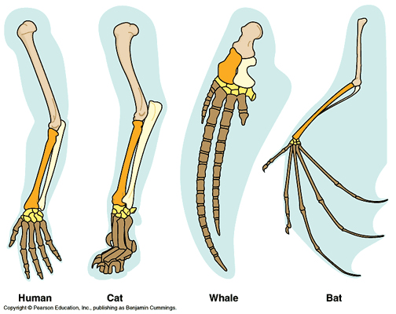
EVIDENCE FOR EVOLUTION
How do we compare species using the fossil record?
Comparative anatomy
Homologous structures- anatomically similar structures.
Let’s read text p. 424

Slide 24
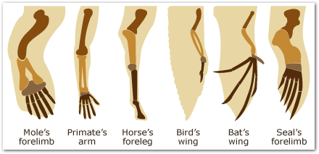
EXPLAIN WHICH ORGANISMS ARE MOST CLOSELY RELATED
Notes:
http://www.slideshare.net/MsJGemmell/comparative-anatomy
https://www.pathwayz.org/Tree/Plain/EVIDENCE+FOR+EVOLUTION

Slide 25
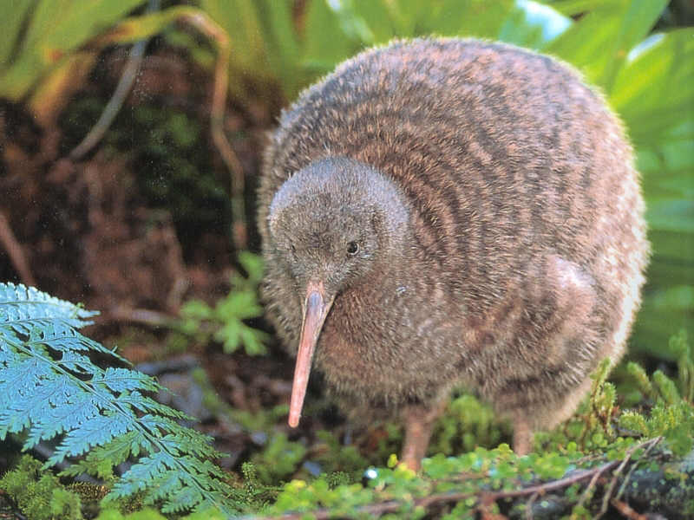
EVIDENCE FOR EVOLUTION
Vestigial Structures
Structures that are reduced forms of function structures in other organisms.
Kiwis Wings are too small to help it fly
Why might it have adapted this way?
Let’s read text page 425

Slide 26
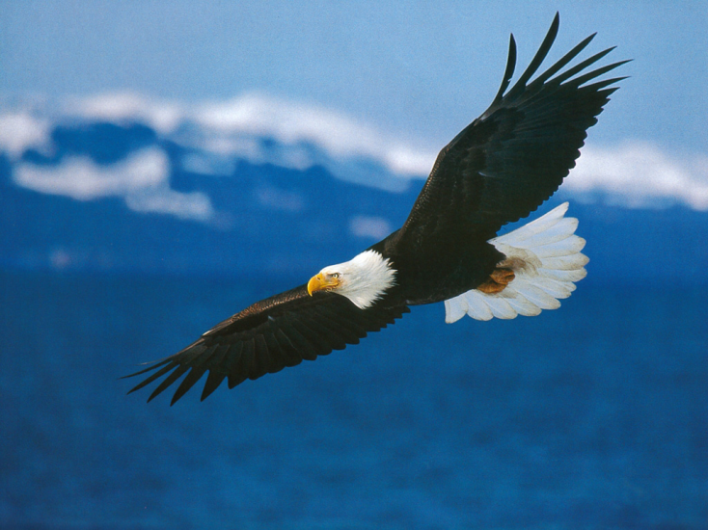
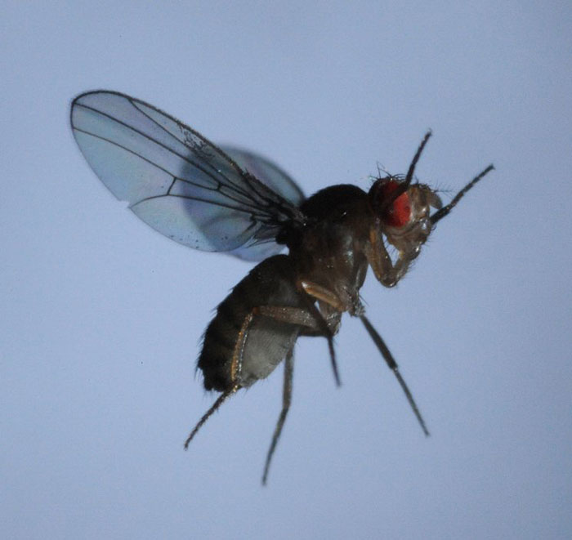
EVIDENCE FOR EVOLUTION
Analogous Structures
Structures that are used for the same function however they are not inherited from a common ancestor.
Eagles wings vs. a Fly
Let’s read text page 426

Slide 27
Check for Understanding
Compare and contrast Homologous, Vestigial, and Analogous structures with a partner (2 minutes).

Slide 28
EVIDENCE FOR EVOLUTION
Comparative Embryology
Comparing embryos of species
Let’s read text page 426

Slide 29
WHAT WAS SO SPECIAL ABOUT THE GALAPAGOS ISLANDS?
Isolated
Differences in species on the islands
Birds’ beaks.
Biogeography
Evolution is linked to climate and geological forces
Species are more similar to fossil record in places where they currently reside.

Slide 30
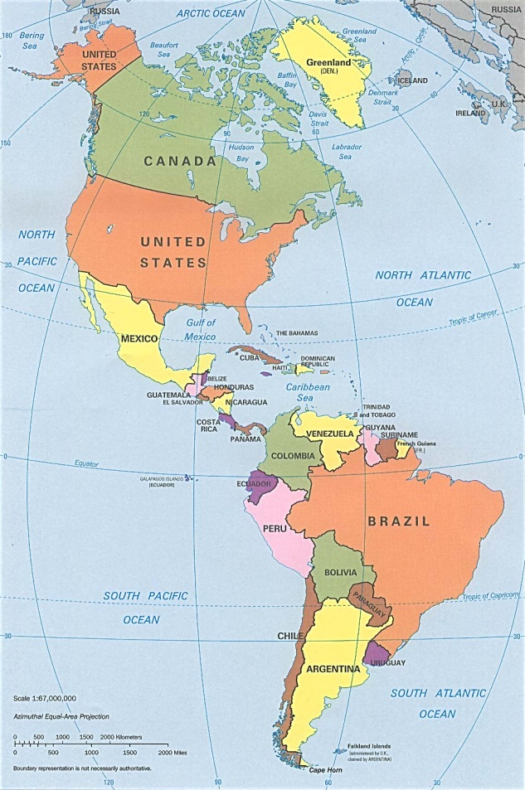
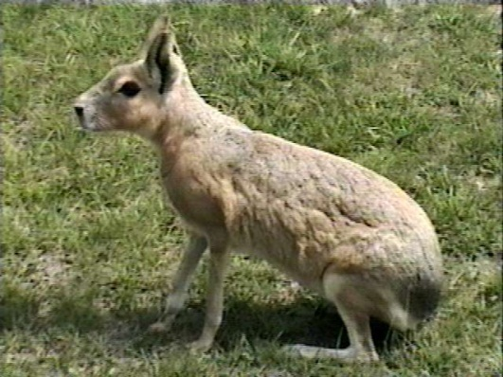
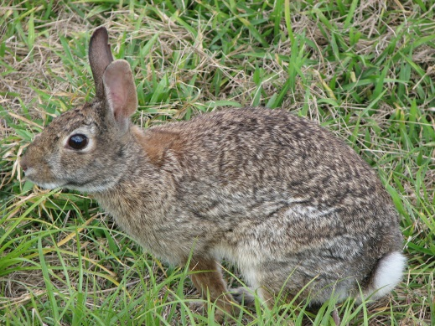
BIOGEOGRAPHY (EVIDENCE)
Mara- Native to South America
Rabbit- Native to North America
The mara (Dolichotis patagonum) exists in a niche similar to that of the English rabbit (Oryctolagus cuniculus).
However, Darwin realized that the mara was more similar to other South American species than it was to the rabbit because it shared a closer ancestor with the South American animals.
Let’s Echo Read Geographic Distribution p. 427-428

Slide 31
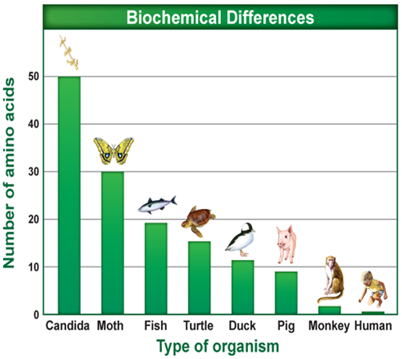
Biochemical Evidence
• Let’s Echo Read Comparative Biochemistry
p.427
Discuss what is this saying with your A/B Partner.

Slide 32
Biochemical Evidence
• Common ancestry can be seen in the complex metabolic molecules that many different organisms share.
• Comparison of the DNA or RNA of different species produce biochemical evidence for evolution
• Comparisons of the similarities in amino acids and other molecules across species reflect evolutionary patterns seen in comparative anatomy and in the fossil record.

Slide 33
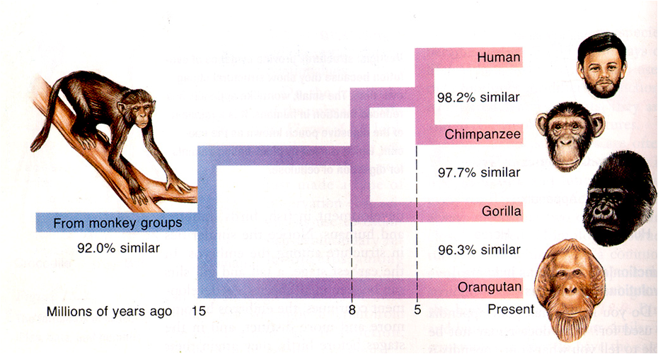
Biochemical Evidence
For example, chimp DNA and human DNA are 98.2% similar!

Slide 34
TYPES OF ADAPTATION MIMICRY AND CAMOUFLAGE 7mins
Be able to come up with a definition of mimicry and camouflage from the examples in the video.
Notes:
https://www.youtube.com/v/UB7tqiL-Eqs

Slide 35
COME UP WITH A DEFINITION OF
Camouflage refers to an animal’s natural resemblance to another object or their ability to change their appearance to be similar to something else.
Mimicry occurs when animals of different species look alike. This can be a defensive mechanism but it can also be due to convergent evolution.

Slide 36
What have we learned...
So far we have learned about many different types of evidence for the theory of evolution. What piece of evidence do you think is strongest for the theory of evolution?
Evidence suggests that the bones in bird wings share a number of features with the bones of dinosaur arms. Based on this evidence, what hypothesis could you make about the evolutionary relationship between birds and dinosaurs?

Slide 37
EOC Practice Questions

Slide 38
EXIT TICKET
List all the current evidence for evolution. See Text pages 423-430.
Notes:
Color Sheet 89 possible HW

