Slide 1
Gas Laws
Chapter 3

Slide 2
Boyle’s Gas Law

Slide 3
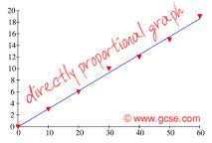
Definitions…
Directly Proportional:
Both variables will either increase or decrease together.
Indirectly Proportional:
One variable will increase and the other will decrease.

Slide 4
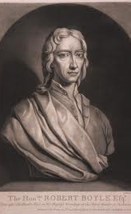
Robert Boyle
Studied the relationship between pressure and volume.
He discovered they were inversely proportional.

Slide 5
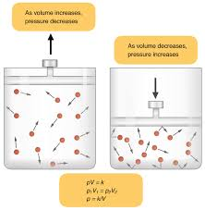
Boyle’s Law
As the volume increases the pressure will decrease.
As the volume decreases the pressure will increase.
This inversely proportional relationship will only be true if the temperature and volume of the gas remain constant.

Slide 6
What do the variables represent?
P1 = Original pressure in the container
V1 = Original volume in the container
P2 = Final pressure in the container
V2 = Final volume in the container

Slide 7
How to Solve for Boyle’s Law…
Every Boyle's Law word problem always gives you three of the four variables.
Of those 3 variables, you have to determine which 2 "pair up". (Which two of the three variables were measured at the same time?)
In order to get "paired" correctly, these get designated as "V1" and "P1" or "V2" and "P2".

Slide 8
Boyle’s Law Sample Problems:
A tank of nitrogen has a volume of 14.0 L and a pressure of 760.0 mmHg. Find the volume of the nitrogen when its pressure is changed to 400.0 mmHg while the temperature is held constant.

Slide 9
How to Solve for Boyle’s Law…
Step 1: Determine what you are solving for by reading the problem.

Slide 10
What are you solving for?
A tank of nitrogen has a volume of 14.0 L and a pressure of 760.0 mmHg. Find the volume of the nitrogen when its pressure is changed to 400.0 mmHg while the temperature is held constant.

Slide 11
How to Solve for Boyle’s Law…
Step 2: Determine and label which numbers are P1, V1, P2 or V2.
P1 = 760 mmHg
V1 = 14.0 L
P2 = 400 mmHg
V2 = ?

Slide 12
How to Solve for Boyle’s Law… Step 3: Plug your numbers into your equation P1 = 760 mmHg V1 = 14.0 L P2 = 400 mmHg
760 mmHg x 14.0 L = 400 mmHg (V2)

Slide 13
How to Solve for Boyle’s Law…
760 mmHg x 14.0 L = 400 mmHg (V2)
10640 mmHg x L = 400 mmHg (V2)

Slide 14
How to Solve for Boyle’s Law…
760 mmHg x 14.0 L = 400 mmHg (V2)
10640 mmHg x L = 400 mmHg (V2)
10640 L = 400 x V2

Slide 15
How to Solve for Boyle’s Law…
760 mmHg x 14.0 L = 400 mmHg (V2)
10640 mmHg x L = 400 mmHg (V2)
10640 L = 400 x V2
400 400

Slide 16
How to Solve for Boyle’s Law…
760 mmHg x 14.0 L = 400 mmHg (V2)
10640 mmHg x L = 400 mmHg (V2)
10640 L = 400 x V2
400 400

Slide 17
How to Solve for Boyle’s Law…
760 mmHg x 14.0 L = 400 mmHg (V2)
10640 mmHg x L = 400 mmHg (V2)
10640 L = 400 x V2
400 400
V2 = 26.6 L

Slide 18
Sample Problem #1
If I have 5.6 liters of gas in a piston at a pressure of 1.5 atm and compress the gas until its volume is 4.8 L, what will the new pressure inside the piston be?

Slide 19
STEP 1: Read the problem and determine what you are solving for

Slide 20
“What will the new pressure be inside the piston?”
You are solving for P2

Slide 21
Step 2: Label your number with variables
P1 = 1.5 atm
V1 = 5.6 L
P2 = ?
V2 = 4.8 L

Slide 22
Step 3: Plug your numbers into your equation
P1 = 1.5 atm
V1 = 5.6 L
P2 = ?
V2 = 4.8 L
P1V1 = P2V2
(1.5 atm) (5.6 L) = P2 (4.8 L)

Slide 23
Use your order of operations PEMDAS
P1V1 = P2V2
(1.5 atm) (5.6 L) = P2 (4.8 L)
8.4 atm x L = P2 (4.8 L)

Slide 24
P1V1 = P2V2
(1.5 atm) (5.6 L) = P2 (4.8 L)
8.4 atm x L = P2 (4.8 L)
8.4 atm = P2 (4.8)

Slide 25
P1V1 = P2V2
(1.5 atm) (5.6 L) = P2 (4.8 L)
8.4 atm x L = P2 (4.8 L)
8.4 atm = P2 (4.8)
4.8 4.8

Slide 26
P1V1 = P2V2
(1.5 atm) (5.6 L) = P2 (4.8 L)
8.4 atm x L = P2 (4.8 L)
8.4 atm = P2 (4.8)
4.8 4.8
1.75 atm = P2

Slide 27
Sample Problem #2
I have added 15 L of air to a balloon at sea level (1.0 atm). If I take the balloon with me to Denver, where the air pressure is 0.85 atm, what will the new volume of the balloon be?

Slide 28
STEP 1: Read the problem and determine what you are solving for

Slide 29
“What will the new volume of the balloon be?”
You are solving for V2

Slide 30
Step 2: Label your number with variables
P1 = 1.0 atm
V1 = 15 L
P2 = 0.85 atm
V2 = ?

Slide 31
Step 3: Plug your numbers into your equation
P1 = 1.0 atm
V1 = 15 L
P2 = 0.85 atm
V2 = ?
P1V1 = P2V2
(1.0 atm) (15 L) = (0.85 atm) V2

Slide 32
Use your order of operations PEMDAS
P1V1 = P2V2
(1.0 atm) (15 L) = (0.85 atm) V2
15 atm x L = (0.85 atm) V2

Slide 33
P1V1 = P2V2
(1.0 atm) (15 L) = (0.85 atm) V2
15 atm x L = (0.85 atm) V2

Slide 34
P1V1 = P2V2
(1.0 atm) (15 L) = (0.85 atm) V2
15 atm x L = (0.85 atm) V2
15 L = (0.85) V2

Slide 35
P1V1 = P2V2
(1.0 atm) (15 L) = (0.85 atm) V2
15 atm x L = (0.85 atm) V2
15 L = (0.85) V2
0.85 0.85

Slide 36
P1V1 = P2V2
(1.0 atm) (15 L) = (0.85 atm) V2
15 atm x L = (0.85 atm) V2
15 L = (0.85) V2
0.85 0.85
17.64 = V2
L

Slide 37
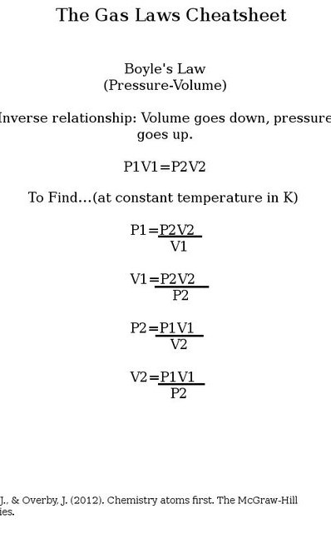
Now, work the rest on your own…

Slide 38
Charles's Gas Law

Slide 39
Definitions…
Kinetic Molecular Theory – states that gas molecules are always in constant motion and bump into each other without loss of overall kinetic energy.
This theory explains the visual properties measured by the eye and is used to understand and explain the gas laws.

Slide 40
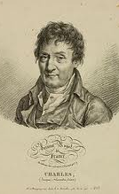
Jacques Charles
French chemist
Isolated the element Boron
Studied and discovered the relationship between the temperature and volume of gases.

Slide 41
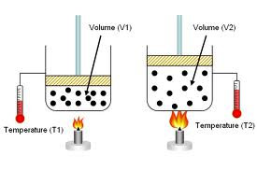
What does Charles's Law tell us?
When there is no change in pressure or the amount of gas, volume and temperature are directly related.

Slide 42
V1/T1 = V2/T2
What do the variables represent?
V1 = initial volume
T1 = initial absolute temperature in Kelvin
V2 = final volume
T2 = final absolute temperature in Kelvin
Charles's Law

Slide 43
Charles’s Law examples in everyday life…
When you spray a can of Lysol constantly for a short period of time, the can becomes cooler.
Explanation: the liquid spray in the can is released therefore decreasing the pressure inside. Since the volume doesn’t change the temperature falls (with a decrease in pressure the temperature decreases too!!)

Slide 44
Charles’s Law examples in everyday life…
Beer or soda cans have a label on them saying “Store in a cool dry place”
Explanation: When the unopened cans are exposed to direct heat or sunlight, the pressure inside the can increases. Since the volume is constant, the pressure increases to the point where it bursts letting out all the pressure

Slide 45
Charles’s Law examples in everyday life…
Leaving a basketball out in cold weather and it loses its volume or air. Once you bring the ball back into a warmer room, it will go back to its original volume.
Explanation: If the pressure in the environment remains constant, then with a decrease in temperature there will be a decrease in volume.

Slide 46
How do you solve for Charles's Law?
The steps to solve Charles’s Law will be the same as those used to solve Boyle’s Law with a few exceptions.
You will be given 3 variables in your problem and you will solve for the fourth variable.
You will need to convert your temperatures to Kelvin and also rearrange your equation to solve for your missing variable.

Slide 47
Charles’s Law Sample Problem…
A 600 mL sample of nitrogen is heated from 27°C to 77°C at constant pressure. What is the final volume?

Slide 48
What is Step 1?

Slide 49
Determine what you are solving for:
Final volume or V2
A 600 mL sample of nitrogen is heated from 27°C to 77°C at constant pressure. What is the final volume?

Slide 50
What is Step 2?

Slide 51
Determine and label which numbers are V1, T1, V2 or T2.
V1 = 600 mL
T1 = 27˚C
V2 = ?
T2 = 77˚C

Slide 52
Since we are solving for V2, we need to rearrange our equation.
V1/T1 = V2/T2
V2 = (V1)(T2)
T1

Slide 53
Before step 3, we have to convert Celsius temperature to Kelvin. So add 273 to your Celsius temperatures:
27˚C + 273 = 300K
77˚C + 273 = 350K

Slide 54
What is Step 3?

Slide 55
Plug the numbers into your equation.
V2 = (V1)(T2)
T1
V2 = (600mL) (350K)
300K

Slide 56
V2 = (600mL) (350K)
300K
V2 = 210000 mL K
300K
Get rid of your like units on the top and bottom.
V2 = 210000 mL K
300K
V2 = 700 mL

Slide 57
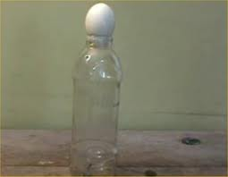
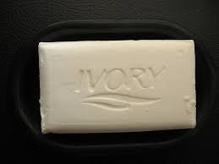
Charles's Law Demos
Egg in a bottle
Ivory Soap in microwave: DO NOT ATTEMPT AT HOME!!!

Slide 58
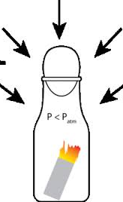
Why did the egg go in the bottle?

Slide 59
Why did the egg go in the bottle…
When the egg was set on the bottle, the air pressure inside the bottle matched the air pressure outside.
When the burning paper was dropped into the bottle, it caused the air inside to heat up and expand rapidly. That expanding air pushed the egg aside and escaped from the bottle.
When the fire consumed all the oxygen inside the bottle, the flame went out and the remaining air in the bottle cooled down.
Cool air takes up less space, exerting less pressure inside the bottle. (The egg acted as a seal to prevent outside air from getting in to fill the extra space.)
The force of the air pushing on the egg from outside the bottle was greater than the force of the air pushing up on it from inside the bottle. Voila - the egg was pushed into the bottle!

Slide 60
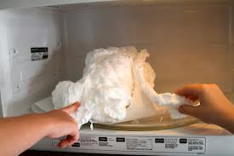
Why did the Ivory Soap turn into a soufflé?

Slide 61
Why did the Ivory soap turn into a soufflé…
Microwave ovens send microwaves waves back and forth through your food. This causes the water, fat, and sugar molecules in the food to rotate and bump into each other, which produces heat.
Ivory soap contains small pockets of air that have water vapor trapped inside of them.
The water vapor inside the Ivory, heats up when the microwave is turned on. This leads to areas of high pressure inside the soap.
Eventually the softened “walls” of the bar can’t hold up to the pressure and the soap starts to bubble and expand. As the soap cools down it stiffens up but keeps its new shape.

Slide 62
Charles Gas Law Practice Problems…
A balloon is filled with 3.0 L of helium at 310 K. The balloon is placed in an oven where the
temperature reaches 340 K. What is the new volume of the balloon?

Slide 63
Step 1: What are we solving for?

Slide 64
V2 or Final volume

Slide 65
Step 2: Label all your numbers with the correct variables

Slide 66
The numbers in the problem are:
3.0L
310K
340K
Label your numbers:
V1 = 3.0 L
T1 = 310K
T2 = 340K

Slide 67
Step 3: Determine which equation you are using. Since we’re solving for V2, we need to use the V2 equation.

Slide 68
V2 = V1 T2
T1

Slide 69
Step 4: Plug your numbers into your equation

Slide 70
Plug it in:
V1 = 3.0 L
T1 = 310K
T2 = 340K
V2 = V1 T2
T1
V2 = (3.0L)(340K)
310K

Slide 71
Get rid of your like units!
V2 = (3.0L)(340K)
310K
V2 = 1020L
310
V2 = 3.29L

Slide 72
A gas at 65°C occupies 4.22 L. At what Kelvin temperature will the volume be 3.87 L?

Slide 73
Step 1: What are we solving for?

Slide 74
T2 or Final Temperature

Slide 75
Step 2: Label all your numbers with the correct variables

Slide 76
The numbers in the problem are:
65°C
4.22L
3.87L
Label your numbers:
T1 = 65°C
V1 = 4.22L
V2 = 3.87L

Slide 77
Step 3: Determine which equation you are using. Since we’re solving for final temperature, we need to use the T2 equation.

Slide 78
T2 = V2 T1
V1
We also need to convert our temperatures to Kelvin…

Slide 79
To convert to Kelvin, we add 273…
65°C + 273 = 338K

Slide 80
Step 4: Plug your numbers into your equation

Slide 81
Plug it in:
T1 = 338K
V1 = 4.22L
V2 = 3.87L
T2 = V2 T1
V1
T2 = (3.87L)(338K)
4.22L

Slide 82
Get rid of your like units!
T2 = (3.87L)(338K)
4.22L
T2 = 1308K
4.22
T2 = 310K

Slide 83
A balloon has a volume of 2500.0 mL on a day when the temperature is 50°C. If the temperature at night falls to 10.0 °C, what will be the volume of the balloon if the pressure remains constant?

Slide 84
Step 1: What are we solving for?

Slide 85
V2 or Final Volume

Slide 86
Step 2: Label all your numbers with the correct variables

Slide 87
The numbers in the problem are:
2500mL
50°C
10°C
Label your numbers:
V1 = 2500mL
T1 = 50°C
T2 = 10°C

Slide 88
Step 3: Determine which equation you are using. Since we’re solving for final volume, we need to use the V2 equation.

Slide 89
V2 = V1 T2
T1
We also need to convert our temperatures to Kelvin…

Slide 90
To convert to Kelvin, we add 273…
50°C + 273 = 323K
10°C + 273 = 283K

Slide 91
Step 4: Plug your numbers into your equation

Slide 92
Plug it in:
V1 = 2500mL
T1 = 323K
T2 = 283K
V2 = V1 T2
T1
V2 = (2500mL)(283K)
323K

Slide 93
Get rid of your like units!
V2 = (2500mL)(283K)
323K
V2 = 707500
323K
V2 = 2190 mL

Slide 94
Calculate the decrease in temperature when 2 L at 20°C is compressed to 1 L.

Slide 95
Step 1: What are we solving for?

Slide 96
T2 or Final temperature

Slide 97
Step 2: Label all your numbers with the correct variables

Slide 98
The numbers in the problem are:
2L
1L
20°C
Label your numbers:
V1 = 2L
V2 = 1L
T1 = 20°C

Slide 99
Step 3: Determine which equation you are using. Since we’re solving for final temperature, we need to use the T2 equation.

Slide 100
T2 = V2 T1
V1
We also need to convert our temperatures to Kelvin…

Slide 101
To convert to Kelvin, we add 273…
20°C + 273 = 293K

Slide 102
Step 4: Plug your numbers into your equation

Slide 103
Plug it in:
V1 = 2L
V2 = 1L
T1 = 293K
T2 = V2 T1
V1
T2 = (1L)(293K)
2L

Slide 104
Get rid of your like units!
T2 = (1L)(293K)
2L
T2 = 293K
2
V2 = 147K

Slide 105
Homework
Math Practice p. 80 #1-3 and p. 81 #9, 10

