Slide 1
Graphing Velocity and Distance vs. Time graphs

Slide 2
Distance-Time Graphs
Time is always plotted on the X-axis (bottom of the graph).
Distance is always plotted on the Y-axis (side of the graph).

Slide 3
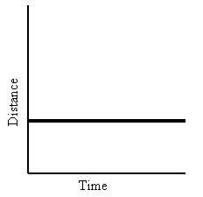
Distance-Time Graphs
If an object is not moving, a horizontal line is shown on the distance graph.
Time is increasing to the right, but its distance does not change. We say it is At Rest.

Slide 4
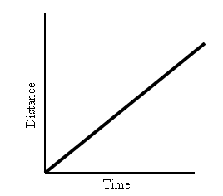
Distance-Time Graphs
If an object is moving at a constant speed, it means it has the same increase in distance in a given time.
Time is increasing to the right, and distance is increasing constantly with time. The object moves at a constant speed.
Constant speed is shown by straight lines on a graph.

Slide 5
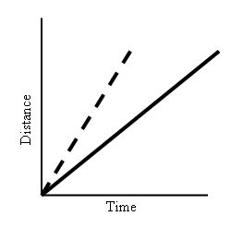
Distance-Time Graphs
Let’s look at two moving objects: Both of the lines in the graph show that each object moved the same distance, but the steeper dashed line got there before the other one:
A steeper line indicates a larger distance moved in a given time. In other words, higher speed.
Both lines are straight, so both speeds are constant.

Slide 6
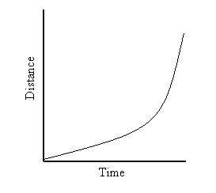
Distance-Time Graphs
Graphs that show acceleration look different from those that show constant speed.
The line on this graph is curving upwards. This shows an increase in speed, since the line is getting steeper:
In other words, in a given time, the distance the object moves is change (getting larger). It is accelerating.

Slide 7
Summary
A distance-time graph tells us how far an object has moved with time.
The steeper the graph, the faster the motion.
A horizontal line means the object is not changing its position - it is not moving, it is at rest.
A downward sloping line means the object is returning to the start.

Slide 8
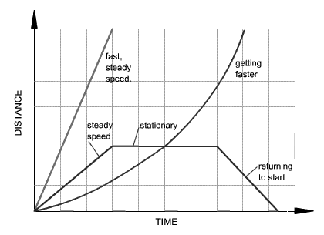
Summary
http://www.bbc.co.uk/schools/gcsebitesize/physics/forces/speedvelocityaccelerationfhrev2.shtml)

Slide 9
Speed-Time Graphs
Speed-Time graphs look much like Distance-Time graphs.
Time is plotted on X-axis
Speed/Velocity is on Y-axis
The slope of a distance vs. time graph is speed.
Slope = Rise/Run

Slide 10
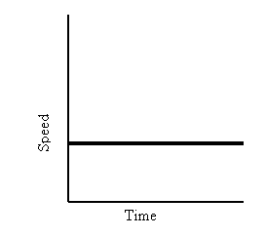
Speed-Time Graphs
A straight horizontal line on a speed-time graph means that speed is constant. It is not changing over time.
A straight line does not mean that the object is not moving!!!!

Slide 11
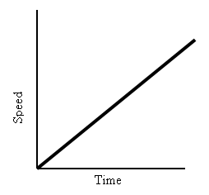
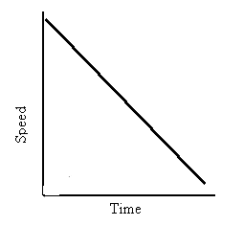
Speed-Time Graphs
This graph shows increasing speed.
The moving object is accelerating.
This graph shows decreasing speed.
The moving object is accelerating in opposite direction.

Slide 12
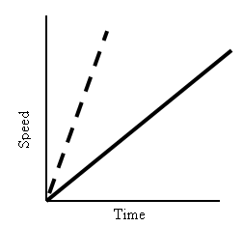
Speed-Time Graphs
What about comparing two moving objects at the same time?
Both the dashed and solid line show increasing speed.
Both lines reach the same top speed, but the solid one takes longer.
The dashed line shows a greater
acceleration.

Slide 13
Summary
A speed - time graph shows us how the speed of a moving object changes with time.
The steeper the graph, the greater the acceleration.
A horizontal line means the object is moving at a constant speed.
A downward sloping line means the object is slowing down.

Slide 14
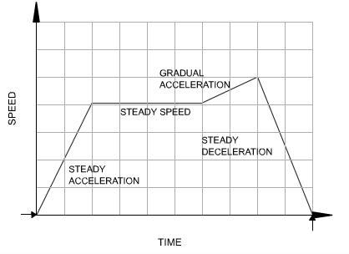
Summary
http://www.bbc.co.uk/schools/gcsebitesize/physics/forces/speedvelocityaccelerationfhrev2.shtml)

Slide 15
Exit Slip
Of the following speed-time graphs, tell me what is happening in each:

