Slide 1
Properties of Matter Review

Slide 2
What are some physical properties we talked about?

Slide 3
Two types of changes
Physical Change
Properties of a material change but the actual material does not change
Chemical Change
occurs when the substance reacts and forms a new substance

Slide 4
Chemical Properties
Flammability
Notes:
The ability for a substance to burn with oxygen

Slide 5
Chemical Property
Reactivity
Notes:
How readily a substance combines with other substances

Slide 6
Recognizing a chemical change
Change in color
Production of a gas
Formation of precipitate
A precipitate is a solid that is formed when two substances are mixed together

Slide 7
Physical or Chemical?
Always ask yourself if new substances are formed after a reaction. If the answer is yes then it is chemical! If no then it is physical!

Slide 8
States of Matter
DO NOW
What are the three states of matter on earth?

Slide 9
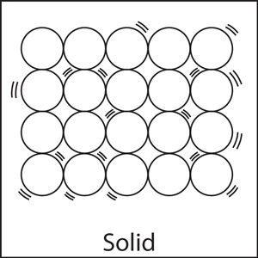
Solids
Have a recognizable shape
Have a definite volume
If I move a pencil from one side of the room to the other does it change shape a volume?
No, that is why it is definite
Atomically

Slide 10
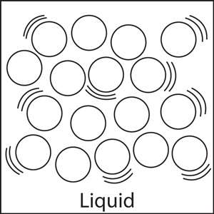
Liquid
Has a definite volume
Does not have a definite shape
Will take the shape of whatever container it is held in
Atomically

Slide 11
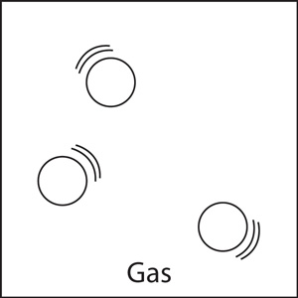
Gas
Does not have definite shape
Will take shape of container it is held in
Does not have definite volume
Volume of gas is equal to volume of container
Atomically

Slide 12
Kinetic Theory
Kinetic theory states that all particles in matter are in constant motion
Kinetic energy is the energy an object has due to its motion
Faster an object moves the more kinetic energy it has

Slide 13
Kinetics in Gas
Particles are never at rest
Particles transfer kinetic energy as they run into each other
Kinetic Theory
Particles of gas are in constant, random motion
The motion of one particle is unaffected by the motion of other particles unless they collide
Forces of attraction among particles in a gas can be ignored under ordinary condtions

Slide 14
Kinetics in Liquids
Lower kinetic energy than gas
Particles in liquids have an attraction to one another
Think of a crowded hallway vs. empty
Thus, they maintain a shape

Slide 15
Solid Kinetics
Have a definite volume and shape
Particles vibrate in a fixed location
Think about people in a movie theatre
Particles stay in place but will not exchange places with neighboring atom

Slide 16
Gas Kinetics Revisited
What do we know?

Slide 17
Gas and Pressure
What happens when we inhale?

Slide 18
Gas and Pressure
Pressure is force exerted over an area
Force is measured in N
Area is measured in m²
So what do we think pressure is measured in?
Pressure is also noted as Pa (pascal)

Slide 19
Homework
Create Vocabulary Card for the following terms: solid, liquid, gas, kinetic energy, pressure
Definition
Examples
DUE THURSDAY
Word
Pictures
2 original sentences using the word; underline the word

Slide 20
Check for Understanding
Grab your CPS

Slide 21
Assessment Questions
Materials are classified as solids, liquids, or gases based on their
temperature and density.
chemical composition.
shape and volume.
reactivity.

Slide 22
Assessment Questions
Materials are classified as solids, liquids, or gases based on their
temperature and density.
chemical composition.
shape and volume.
reactivity. ANS: C

Slide 23
Assessment Questions
Which of the following statements describes gases based on the kinetic theory?
Particles of gas are in motion part of the time and stationary part of the time.
Particles in a gas are arranged in an orderly fashion.
Gas particles are not affected by collisions with other gas particles.
Forces of attraction between particles can be ignored under ordinary conditions.

Slide 24
Assessment Questions
Which of the following statements describes gases based on the kinetic theory?
Particles of gas are in motion part of the time and stationary part of the time.
Particles in a gas are arranged in an orderly fashion.
Gas particles are not affected by collisions with other gas particles.
Forces of attraction between particles can be ignored under ordinary conditions. ANS: D

Slide 25
Assessment Questions
Most of the matter of the universe exists in which state?
solid
gas
plasma
Bose–Einstein condensate

Slide 26
Assessment Questions
Most of the matter of the universe exists in which state?
solid
gas
plasma
Bose–Einstein condensate ANS: C

